Slide 1
Prince William County Sustainability Commission
Annual Report for 2025 to the Board of County Supervisors
Summary of Advisory Activities, CESMP Progress, and Key Issues
[date, 2026]
Presented to: Supervisor XX
Presented by: Sustainability Commissioner YY

Slide 2


Objectives & Outline
Briefing Objectives:
  Summarize Sustainability Commission advisory activities in 2025
  Highlight CESMP-related progress and emerging risks
  Identify challenges and priority issues for Board consideration in 2026
Outline
  Background
  Key accomplishments in 2025
  Challenges
  Next Steps

Slide 3

Background
Nov 2020: BOCS adopted five climate, energy, and sustainability goals
  The MWCOG regional Climate Mitigation (CM) Goal of 50% greenhouse gas (GHG) emission reductions below 2005 levels by 2030,
  The MWCOG regional Climate Resilience (CR) Goal of becoming a Climate Ready Region and making significant progress to be a Climate Resilient Region by 2030.
  A county-specific goal for Prince William County Government operations to achieve 100% renewable electricity by 2030,
  A county-specific goal of 100% of Prince William County’s electricity to be from renewable sources by 2035, and
  A county-specific goal for Prince William County Government operations to be 100% carbon neutral by 2050.

Slide 4

Background
Dec 2021: BOCS
  Authorized development of Community Energy & Sustainability Master Plan (CESMP) to provide a roadmap for accomplishing these goals, and
  Created the Sustainability Commission (SC) to guide the county on developing CESMP policies and programs.
May 2022: SC has initial meeting

Slide 5
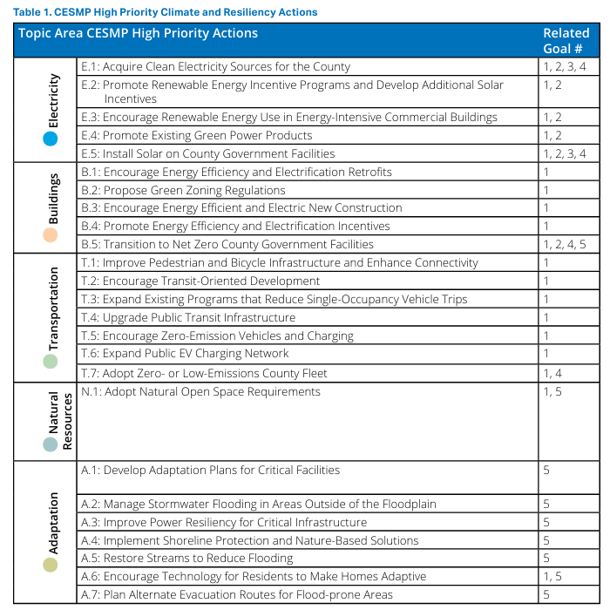
Background
CESMP was developed through extensive consultation and coordination across PWC agencies and with considerable public input and support
Core recommendations include 25 high priority actions and 3 foundational program-wide sustainability initiatives:
  Implementation of an “Adaptive Management” approach that improves our ability to make decisions in the face of uncertainty and complexity
  Assessments of climate mitigation and resiliency impacts performed by the County to provide data on a project’s impact on GHG emissions, renewable and fossil energy mix, and climate resiliency metrics
  Institutional capacity-building to support sustainability, including staffing capacity to pursue federal grants and for communication and outreach
Nov 2023: BOCS approves and adopts CESMP

Slide 6
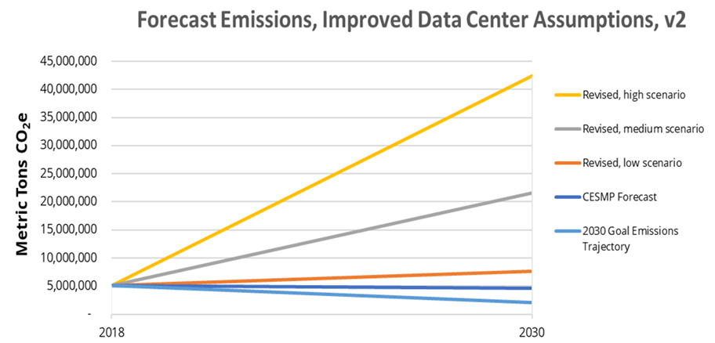
Background
Since approval of CESMP, as mandated by the BOCS, SC submitted
  an annual report Sustainability Commission Prog Rpt to BOCS -Final.pdf in January 2024.
  a progress briefing for Supervisors in January 2025
This briefing provides an update on activities from Jan 2025 - Dec 2025
Updated Carbon Emission Forecast from Jan 2025 Progress Briefing

Slide 7
Key Accomplishments in 2025
Overview
In 2025, the SC transitioned from foundational planning to rigorous policy analysis and implementation oversight. This year was defined by a critical realization:
While PWC has established a sound plan (the CESMP), the rapid pace of commercial/industrial (particularly data center) and residential growth requires immediate and aggressive policy intervention to keep our 2030 climate targets within reach.
In fact, carbon emissions growth from data centers in PWC (and Loudoun) will probably prevent the entire MWCOG region from meeting its carbon emission goals.
The SC gathered info and facilitated coordination on the most important issues facing PWC (slides 8-10 on briefings and coordination).
Based on our research and insights, the SC provided recommendations to the BOCS on policy and resource management (slides 11-13 on resolutions)

Slide 8
Key Accomplishments in 2025
Selected Briefings and Coordination
Strategic Plan Initiatives & Budget Updates: Updates on the integration of sustainability into the County Strategic Plan and the status of FY27 budget requests for new mobility and communications managers.
  Organization: PWC Office of Sustainability (Giulia Manno, Director)
Prince William Water’s Resilience Plan – water/electricity tradeoffs: Follow up on the inverse relationship between water use and electricity use in data center cooling systems
  Organization: Prince William Water (Dan Pannell, COO and Sustainability Commissioner)
On-Road Transportation GHG Reduction Strategies: Implementation considerations for reducing carbon emissions, focusing on the 7 transportation actions in the CESMP
  Organization: ICF International (Michael Grant, VP of Transportation)
Data Center Dynamic Virginia 2025 Conference Debrief: summary of regional trends, power demand forecasts, and emerging state policies discussed at the statewide data center summit
  Organization: PWC Office of Sustainability (Yi Sun, Sustainability Performance Manager)

Slide 9
Key Accomplishments in 2025
Selected Briefings and Coordination
Transit-Oriented Development (TOD) Mapping: demonstration of Montgomery County’s map tool for tracking TOD progress and a review of how Prince William can apply similar data visualization to local land-use projects
  Organization: SC (Martin Jeter, President of MIDCO and Chair of SC)
Build-Out Analysis Dashboard: update on the development of a tool to provide an accurate picture of approved vs. planned commercial and residential development in relation to county climate goals
  Organization: PWC Planning Office (Tony Alston and David McGettigan)
Transit Oriented Development: Case Study – Potomac Shores
  Organization: Virginia Railway Express (Christine Hoeffner, VRE Director of Planning and Environmental Policy, and Sustainability Commissioner)
Transit Oriented Development: Case Study – Mayfield Crossing
  Organization: SC (Martin Jeter, President of MIDCO and Chair of SC)

Slide 10
Key Accomplishments in 2025
Selected Briefings and Coordination
School Sustainability Update: energy efficiency performance, renewable energy projects, and how PWCS is aligning its strategic plan with the county’s broader sustainability goals
  Organization: PWCS (Jessica Weimer, Energy Management & Sustainability Supervisor)
CESMP integration into Transportation Planning: how the actions in the CESMP are being incorporated in transportation projects and strategies
  Organization: PWC Transportation Department (Paolo Belita, Dep. Director)
CESMP integration into Emergency Management: how the actions in the CESMP are being incorporated in EM projects and strategies
  Organization: PWC Office of Emergency Management (Brian Misner, EM Coordinator)
Solar project permitting in PWC: update on lowering barriers to scaling up residential and commercial solar projects in PWC
  Organization: Solar United Neighbors (Aaron Sutch, Atlantic SE Regional Director)

Slide 11
Key Accomplishments in 2025
Resolutions
Resolution | Result
2025 legislative agenda recommendations. Recognizing limits on local authority to mitigate sustainability impacts of data centers, advocated for statewide data center regulation. Resolution No. 25-005: Recommendations on Virginia Legislation on Data Centers supported measures to condition state sales and use tax exemptions on the use of zero-carbon electricity (at least 90%) and advocated for impact studies—including greenhouse gas (GHG) and energy assessments—prior to the siting of new facilities. | Some recommendations were included in PWC legislative agenda, and were elements of data center bills that passed the GA, but all were ultimately vetoed.
Proposed Targeted Staffing for CESMP Implementation. Resolution No. 25-007: Office of Sustainability Budget Request for Staffing identified critical resource gaps in executing the CESMP and formally requested the BOCS to fund additional full-time positions for the Office of Sustainability to ensure the county remains on track to meet its 2030 climate goals. | Green Buildings Mgr and Climate Risk/Resilience Mgr positions approved in FY26 budget. Green Mobility MGR and Outreach/Engagement Mgr positions added to 5-year plan in the FY27 budget

Slide 12
Key Accomplishments in 2025
Resolutions
Resolution | Result
Recommended an analysis of water, energy, and GHG tradeoffs for data center cooling systems to inform permitting decisions. Cooling system design has been a key element of proffers, but there’s an inverse relationship between water use and energy use/ GHG emissions that the County needs to understand and manage, per Resolution No. 25-009: Recommendations on Water and Energy Use by Data Centers. The Commission also recommended that the use of groundwater by data center projects should be prohibited to protect the local aquifer and private well owners. | No apparent action by BOCS or county staff.
Advanced Transit-Oriented Development (TOD) Tools To reduce transportation emissions—one of the county's highest-emitting sectors—the Commission supported the adoption of a Map Tool to guide Transit-Oriented Development. This initiative aims to align future housing and commercial growth near high-capacity transit corridors. Resolution No. 25-018: Transit-Oriented Development Map Tool | Planning Office is updating PWC mapper, but TOD is not explicitly incorporated.

Slide 13
Key Accomplishments in 2025
Resolutions
Resolution | Result
Recommendations for the 2026 Legislative Agenda Coming full circle, the Commission concluded the 2025 cycle by providing recommendations for the upcoming 2026 legislative session. This included a continued focus on data centers; studying municipal aggregation; and removing barriers to scaling up solar, such as utility interconnection fees for mid-sized projects. Resolution No. 25-019: Revision on Legislative Agenda Recommendations | Several recommendations incorporated in PWC input to VACo.

Slide 14




Challenges
Unchanged from Jan 2025 progress report: CESMP requires departure from business as usual in order to achieve CM/ CR goals. Current growth trends and approved development patterns present increasing challenges to achieving the goals.
  GHG emissions are increasing rather than dropping by 0.5x. Available forecasts suggest that continued growth in data center energy demand represents a material risk to the MWCOG region’s ability to achieve its CM goals
  Countywide clean energy goal is slipping away due to vast increase in electricity use without clean energy requirements
  Climate resilience is only improving slowly
  Leadership from staff, the Planning Commission, and the BOCS is needed to achieve the land-use goals

Slide 15
Challenges (con’t)
Barriers in the current Comprehensive Plan to achieving GHG goals through Transit-Oriented Development (TOD):
The nine MWCOG PWC Activity Centers are on the I-66 and I-95 corridors, while PWC has 24 “Activity Centers” and nine more “Small Area Plans” scattered around the county that dilute the effort to increase ridership by increasing housing density far from high-capacity transit.
The Omniride bus system is not designed to move folks expeditiously to high-capacity transit stations, which limits ridership. Expanding and subsidizing the bus system to serve all the scattered Activity Centers, etc. rather than concentrating new growth near the existing high-capacity transit areas will detract from the goals of increased ridership and reduced GHG emissions.

Slide 16
Challenges (Cont’d)
Actions by citizens and businesses will be needed to accomplish CM/ CR goals, but there’s little awareness – much less action – in the community.
There’s a huge gap in resources needed to implement the CESMP actions versus the budget allocated to Sustainability Office and other offices responsible for actions. The current budget request asks for a large increase with respect to FY27, and this amount will need to be ramped up considerably for the next several years if the CESMP is to be implemented successfully.
In short, there’s a significant risk that PWC will not achieve the CM/CR goals, and will even prevent the rest of the MWCOG region from meeting the goals.

Slide 17
Next Steps
  Sustainability Commission Advisory Priorities
    Continue advancing CESMP foundational actions:
      Adaptive management and metrics
      Expanded climate impact assessments
      Institutional capacity-building
    Support integration of CESMP into:
      Strategic Plan
      Comprehensive Plan updates
      Zoning text updates
      Design and Construction Standards Manual (DCSM) updates

Slide 18
Next Steps (Cont’d)
  Recommendations for BOCS Consideration
    Develop policies to mitigate impacts of data centers on CM goals
      Eliminate DCOZOD
      Narrow targeted industry list to only include data centers that make clean energy and energy efficiency commitments
      Develop policy around balancing energy and water use
      Develop policy around requiring water and energy use public reporting
      Develop policy around reduction of water and energy use in existing and planned facilities

Slide 19
Next Steps (Cont’d)
  Recommendations for BOCS Consideration
    Incorporate tracking tools as performance measures for achieving TOD
    Focus the majority of new residential and mixed-use development in areas near high-capacity transit using planning tools such as comprehensive plan density ranges
    Evaluate staffing and resource needs tied to implementation outcomes
    Focus on cost-effective, high-impact actions

Slide 20

Questions?

