Slide 1

Affordable Housing Fund (AHF)
Pre-Application Meeting
March 11, 2026
Notes:
Joannie will introduce and make opening remarks. Then Ivette and staff will present.

Slide 2
Agenda
Welcome and Introductions
Responses/Discussion of Questions from February 25th AHF Introduction Meeting
Scoring Criteria & Appendix A
Application and Submission Process
Questions
Notes:
Welcome back
Icebreaker
Agenda
Housekeeping items

Slide 3
Responses to Questions
1) Question: Is this loan “must pay” or soft pay debt (i.e., cash flow dependent)?
Answer: The loan provided through the AHF fund will be in a second trust position, paid out of available project cashflow after paying debt service obligations, and must be fully repaid.
2) Question: Does the AHF application have any prerequisite or threshold requirements and/or do projects have to get to a certain point in the land-use entitlement phase before applying?
Answer: The current AHF application does not have prerequisite nor threshold requirements. However, it may be difficult to score well on “project readiness” without having land-use entitlement.

Slide 4
Responses to Questions – Slide 2 of 5
3) Question: Given the typical construction length of new construction apartment communities, can the one-year construction period be extended (e.g., to three years), until the project converts to permanent financing. This would require a 5-to-6-year total period instead of the 3-year total period mentioned in the Policies and Procedures?
Answer: When reviewing the applications the review team will take into consideration requests concerning extension of the loan’s construction period, based upon the presented development project initiating the request.
4) Question: How does the AHF commitment work alongside the highly prescriptive, formulaic Virginia LIHTC application requirement to earn subsidy loan commitment before a competitive LIHTC application?
Answer: Staff understands that the Virginia LIHTC application awards points for local subsidy loans committed before the LIHTC application and will endeavor to meet that timing requirement. Applicants should within the application for funding provide anticipated LIHTC request as it relates to the overall project funding.

Slide 5
Responses to Questions – Slide 3 of 5
5) Question: Can AHF funds come in during the construction period, i.e., 50% up front?
Answer: The initial funding for approved projects is being consider and will be discussed at the time applications are reviewed.
6) Question: The meeting slides indicate that the “AHF loan must be 20% or less of the total non-County funding of the development costs…” Does this mean that the County loan is limited to 1/6 of the development costs? Or limited to 1/5 of the development costs? A: No more than 20% of total costs so no more than 1/5?
Answer: The approved AHF funding will be no more than 20% of total costs, so no more than 1/5.
7) Question: Can we negotiate a greater than 30-year payback term since the affordability periods can be longer than 30 years?
Answer: The initial funding as well as the consideration for a longer repayment term for approved projects can be considered however there must be extenuating support for this request and will be discussed at the time applications are reviewed.

Slide 6
Responses to Questions – Slide 4 of 5
8) Question: When a multi-building, multi-family project is being proposed, the primary contractor usually sub-contracts to another developer to build one or two of the buildings as 100% affordable. Can these projects apply for the AHF?
Answer: Yes, applicants are not required to use the AfDU Ordinance for bonus density or waivers to apply for the AHF. Any questions regarding dispersion of units and/or dispersion of buildings within the development in the land-use entitlement process are questions for the Planning Office and/or Land Development Division depending on the circumstance.
9) Question: We want to verify that PWC has no minimum score needed for the AHF and PWC does not participate in project-based vouchers?
Answer: Correct, no minimum score is required and PWC does not currently or anticipates future provision of project-based vouchers when using the AHF funds for projects.

Slide 7
Responses to Questions – Slide 5 of 5
10) Question: Several general questions regarding whether or not PWC has designated any “revitalization areas” in the Virginia Housing process.
Answer: No, to the best of our knowledge PWC has not designated any “revitalization areas” per Virginia Housing.

Slide 8
Additional Questions – from 03-05-2026 email – Slide 1 of 5
Financing Terms
Interest Rate
  Other localities have successfully provided the interest rate on these loans down to 3%. Can Prince William still explore that? – Answer: No. The Board of County Supervisors has approved the Affordable Housing Fund Guidelines and Procedures as presented with the interest rate tied to the 10-year Treasury Rate, so for this round of applications for consideration there is no change in the terms approved within the document.
Construction Term
  Echoing other comments about changing the one-year period for construction to a three-year period: That period needs to cover not just construction but also lease-up to stabilize the property (you can't convert to a permanent loan until you hit a certain occupancy threshold) and then the actual conversion to the permanent loan. That's why the longer term is helpful since it would be difficult as currently proposed. Answer: See answer to question #3 on a slide #4.

Slide 9
Additional Questions/Recommendations – from 03-05-2026 email – Slide 2 of 5
Zoning:
  Zoning approval should be required by the end of the application year (i.e., if I apply 8/1/2026, then I need to have zoning by 12/31/2026). Zoning should be a requirement so that funding is going to a project that the Board said the applicant can build. Answer: There can be no amendments to the Scoring Criteria, it was approved by the BOCS on 02-03-2026. That said, The Affordable Housing Fund Policies and Guidelines addresses zoning with regards to the loan application package, application requirements/checklist and project scoring on pages: 17, 22 and 27, respectively.
Site Control:
  Site control should be a requirement so that funding is going to a project on a site the applicant controls. Answer: There can be no amendments to the Scoring Criteria, it was approved by the BOCS on 02-03-2026. That said, The Affordable Housing Fund Policies and Guidelines addresses site control with regards to the loan application package, application requirements/checklist and project scoring on pages: 11, 22, 23, 25 and 27, respectively.

Slide 10
Additional Questions/Recommendations – from 03-05-2026 email – Slide 3 of 5
Architectural concept plan:
  The scoring criteria reference a construction set, but that comes much later in the development process. At the application stage, a schematic design set is more appropriate. This basic design that shows the expected plan and explains what the applicant is trying to do, with details finalized later as the project progresses. Answer: In support of your application/project OHCD will accept and review all relevant documentation that is provided and supports your project. Please include all supporting documents relevant to your application/project at submission of your application.

Slide 11
Additional Questions/Recommendations – from 03-05-2026 email – Slide 4 of 5
Scoring Criteria
Unit count and affordability:
  If highest consideration is given to applications that provide the most units at the lowest AMI levels, then there should be a minimum scoring threshold for the entire application that incentivizes the kind of developments PWC hopes to see. Fairfax County has a minimum score of 42 out of 100 to be awarded funding.
  Answer: There can be no amendments to the Scoring Criteria, it was approved by the BOCS on 02-03-2026.

Slide 12
Additional Questions/Recommendations – from 03-05-2026 email – Slide 5 of 5
Project Readiness:
  Same note as above regarding construction plans...that level of detail comes later. Other counties are comfortable with schematic design at the application stage.
  Re final site plan approval: This typically happens closer to closing, so it's unlikely applicants will have it early on when applying. Another approach is to make it a condition of closing rather than an application requirement, which is how Virginia Housing handles it. It's fine to incentivize it in scoring, but wanted to flag that it comes later in the process.
  Answer: There can be no amendments to the Scoring Criteria, it was approved by the BOCS on 02-03-2026.

Slide 13
Affordable Housing Fund
Project Submission
Project Requirements for Submission & Review
Annual Competitive Application Process through annual Notice of Funding Availability (NOFA)
Office of Housing & Community Development Affordable Dwelling Unit Division staff will review applications for completeness and initial eligibility
An interdepartmental Housing Application Review team, led by OHCD staff, will review and discuss the applications. The Housing Application Review Team will include at least staff from the OHCD, Planning Office, Office of Management, Budget, Finance Department and Department of Development Services, with consultation with the County Attorney’s Office as needed
Funding decisions will be made based on the merits of each loan application as graded in accordance with the AHF Guidelines scoring criteria, terms contained in the NOFA, and the availability of resources in the AHF
Notes:
There will be an Annual Competitive Application Process through Notice of Funding Availability (NOFA)
The Office of Housing & Community Development (OHCD) Affordable Dwelling Unit Division staff will first review all applications to ensure they are complete and meet the initial eligibility requirements of the program.
An Application review team lead by the Office of Housing and Community Development comprised of staff from different Prince William Departments will assess, discuss and score the applications, based upon the Board approved criteria.
This team will include representatives from the Office of Housing, the Planning Office, the Office of Management and Budget, the Department of Finance, and the Department of Development Services. Additionally, the County Attorney’s Office will be consulted as needed.
Funding decisions will be based on the merits of each loan application. Applications will be scored according to the
AHF Guidelines criteria,
the terms outlined in the NOFA, a
and the availability of funding resources in the Affordable Housing Fund (AHF).

Slide 14
Affordable Housing Fund (AHF) Uses
Eligible Uses
Construction, rehabilitation and preservation of housing in the County and related costs for affordable rental and owner-occupied housing.
Ineligible Uses
Operating expenses
Social services
Project reserves, except if required by Virginia housing or HUD
Hard or soft cost contingencies
Developers’ fees
Builder’s profit
Syndication related costs
Construction Management fees
Development/financing consultant fees or fees for other non-development related services, including funding guarantee or reserve accounts required by lenders or investors
Units for rent or sale at market rate
Financing fees
Notes:
Eligible Uses
Affordable Housing Fund dollars must support activities directly related to creating or preserving affordable housing in the County. Allowable uses include:
1. Construction, Rehabilitation & Preservation
New construction of affordable rental or owner-occupied units
Rehabilitation of existing housing to maintain affordability
Preservation activities that protect long-term affordability
2. Related Housing Costs
Costs that directly support the development or rehabilitation of affordable units
Expenses necessary to ensure the housing is safe, functional, and compliant with code requirements
Projects directly tied to producing or maintaining income-restricted units
Non-Eligible Uses
Affordable Housing Fund dollars cannot be used for items that do not directly support the physical production or preservation of affordable housing. Prohibited uses include:
1. Operating or Business Costs
Routine, day-to-day operating expenses of an organization
Staff salaries unrelated to a specific construction/rehab activity
2. Social Services
Any services provided to residents or communities (e.g., counseling, education, case management)
3. Project Reserves
General project reserves
WITH THE Exception: Reserves specifically required by Virginia Housing or HUD
4. Contingencies
Hard cost contingencies (5%-10% budget reserves set aside to cover unforeseen expenses related to physical, on-site construction…materials price surges, unsuitable site conditions)
Soft cost contingencies (budget reserves 10-20%, set aside to cover non-physical expenses such as permit price hikes, extended loan interest due to delays, increased design fees, etc)
(Expectation: developers must provide accurate, fully formed budgets)
5. Developer Financial Benefits
Developer fees
Builder’s profit
6. Syndication-Related Costs
Brokerage fees
Legal or accounting fees tied to syndication activities
7. Construction Management Fees
Which are typically, 3–15% of project costs—not allowable from the Fund’s resources
8. Consultant or Financing Fees
Development or financing consultant fees
Fees for services not directly related to the project development
Funding guarantee or reserve account fees required by lenders/investors
9. Market-Rate Units
Costs for units that will be rented or sold at market rate
10. Financing Fees
Lending fees such as:
Loan origination, Construction loan interest due; and Bridge loan expenses

Slide 15
Affordable Housing Fund
Scoring Criteria
Loans may be approved for less than the full amount requested in the loan application, and if multiple projects apply for the AHF, project scores may be used to compare projects.
Highest consideration will be given to loan applications that demonstrate that the project will rehabilitate, construct and/or preserve the greatest number and highest quality affordable units to serve County households at the greatest need in the most economically sustainable way and meet AfDU Ordinance provisions when applicable.
Notes:
Each application will be evaluated on how well the proposed project meets the goals of the program (for example: creating or preserving affordable housing, serving a target population, financial feasibility, readiness, etc.). The “merits” include qualitative and quantitative strengths of the application.
Applications may be approved for loans for less than the amount requested, and when there may be several projects that apply, scores can be used to compare them.
Applications receive the highest consideration when they show that the project will produce, preserve, or improve the largest number of high-quality affordable housing units, especially for households with the greatest need. Projects are also ideal when they do this in a financially sustainable way and meet applicable AfDU Ordinance requirements.

Slide 16
Affordable Housing Fund (AHF)
Scoring Criteria
Category | Maximum Points/Percentage(s)
Affordability Proposal | 35 Points
Financial Proposal | 25 Points
Project Readiness | 8 Points
Experience | 17 Points
Development Concept | 15 Points
Total | 100 Maximum Points
Notes:
The scoring criteria was designed to ensure that the AHF funding is being allocated effectively based on both local needs, and Affordable Dwelling Unit and Affordable Housing Fund Program priorities.
The Affordability Proposal consists of a maximum of 35 points, the highest points category. This reflects a funding priority given to the project affordability period, the AMI served, and whether the project will have units with accessibility features, and/or senior housing.
A second priority is given to the project’s Financial Proposal. The following factors will be considered in this category: firm financial commitments from the other sources of funding, the project’s budget, the income projections and operating costs.
Project Readiness category will be assessed based on the applicant’s ability to start the project. We will look at the status of the construction plans permits, the milestone schedule, any relocation plans, if applicable.
The Experience category review will include assessing years of experience in construction and development of affordable housing. Experience in developments of equivalent size, type and complexity.
The Development Concept category will assess the type of projects, is it mixed-use, mixed income, what amenities are being offered, is the project close to activity centers and transportation, jobs, bike trails, libraries, etc. Is there consideration for green building standards.

Slide 17
Scoring Criteria
Affordability Proposal
1 | Affordability Proposal | Complete the Development Description Form (Appendix A) including information related to affordability period, area median income served, units bedroom count, persons served (e.g., seniors, persons with disabilities, etc.) Highest Points given to: 50 years’ commitment to maintaining the affordability of units consistent with targeted households as proposed. 50% or more units will serve households with incomes at 50% AMI or below. Ten percent (10%) or more of the project units to benefit households with incomes at or below 30% AMI. 25% or more are family-sized units of three bedrooms or more unless the project is specifically for senior housing. Senior housing for older adults or persons with disabilities, twenty percent (20%) or more of the project units be fully accessible meeting the requirements of the Americans with Disabilities Act (ADA), the Fair Housing Act, and the American National Standards Institute 117.1. | 35

Slide 18
Scoring Criteria
Financial Proposal
2 | Financial Proposal | Complete the Development Description Form (Appendix A) including: (1) Sources and Uses; (2) Rent Schedule; (3) Forty-year Rental Pro Forma; (4) Summary of For-Sale Revenue; (4) Proposed percentage of cash flow and capital transaction proceeds to repay the loan; (5) evidence of any funding commitments. Considerations: The applicant has submitted firm financial commitments for other sources of financing, shown the financing gap of the project, and demonstrated consistency with accepted underwriting standards. The project proposed to utilize public and private partnerships and utilizes local, state and federal housing programs to assist in fulfilling unmet housing needs and addressing the financing gap. The project budget is clear, accurate, thorough, and contains a realistic set of sources and uses. Applicant presents evidence of maximizing resources to minimize construction costs as much as possible and within compliance with industry standards. The applicant has submitted documentation of a leverage ratio of 1:5 (AHF’s sources to other sources) or higher. Ratios not rounded up. Income projections are reasonable and consistent with rents/mortgages of targeted households and vacancy rates. Operating costs are consistent with those documented of other recent local similar developments. | 25

Slide 19
Scoring Criteria
Project Readiness
3 | Project Readiness | Complete the Development Description Form (Appendix A) including a timeline describing key milestones for the development including site control, zoning, design, permitting, construction, and lease up/conveyance. Provide the legislative number for the approved zoning case or zoning case under review, and a copy of any approved proffers associated with the zoning. Considerations: Construction plan and documents (architectural and/or engineering, specifications) are permit-ready, and the construction budget is aligned with such plans; the final site development permit has been issued by the County and remains valid. Demonstrated feasible plan through the documents/information provided within the loan application package and a reasonable milestone schedule. Preservation of property with an existing and/or expiring affordability deed/covenant restriction and/or operating subsidy or a below-market rate property with the goal of upgrading the housing quality and commitment to an extended affordability period. Displacement prevention policy and/or plans that assist and facilitates residents in remaining in affordable housing units. N/A for new construction. | 8

Slide 20
Scoring Criteria
Experience – Slide 1 of 2
4 | Experience | Design team with extensive (at least 10+ years) experience in construction and green design such as, but not limited to, Passive House, Energy Star, LEED or EarthCraft Gold, and Universal Design. Selected general contractor demonstrated record of successful completion of past projects of equivalent size, scale, type, and complexity to the proposed project having delivered similar projects on time, on budget, and to the highest quality standards. Documentation of experience as a developer of affordable housing, to include taking projects through a community process and obtaining approvals; receiving LIHTC; inclusion on the Virginia Housing experienced developer list; closing on debt and equity financing; history of repayment and obtaining building permits. Demonstrates successful record in projects of equivalent size, scale, type, and complexity to the project proposed, including demonstrated ability to maintain ongoing compliance over the life of a project. | 17

Slide 21
Scoring Criteria
Experience – Slide 2 of 2
4 | Experience | Demonstrates a successful record in project of equivalent size, scale, type, and complexity to the proposed project and has experience to ensure that proposed design is compliant with all applicable federal, state, and County laws, codes, ordinances, regulations, and requirements, including, but not limited to, environmental, accessibility standards, zoning, Building Code, and historic preservation. Architect and/or construction manager have capacity/experience to provide project oversight to guarantee delivery on time, and on budget. Demonstrated record of successful partnerships with social service providers and of having provided excellent management and support services to special needs populations such as people with disabilities and the elderly. Fiscally and organizationally sound, as evidenced by the financial statements. The applicant has the financial and workload capacity to make the project a top priority, execute it as scheduled in terms of time and budget. Applicants must identify key personnel – project manager, managers and other key personnel – who will be directly involved in the project in the project’s entirety and provide personnel resumes and bios. Any changes/substitutions in key personnel identified in the proposal must be approved by the County. | 17

Slide 22
Scoring Criteria
Development Concept
5 | Development Concept | Complete the Development Description Form (Appendix A) to demonstrate how the project will provide a mix of housing prices (acquisition and/or rental) that accommodate a mix of income levels. The project will provide on-site amenities that may include, but not be limited to, community meeting rooms, outdoor playground, swimming pool, green space, community garden, among others. Project is located within walking distance (approximately 0.5 mile) to County Activity Centers, Redevelopment Corridors, or Small Area Plans. The project is located proximately to public transportation facilities and is easily walkable to amenities including employment opportunities, schools, grocery stores, public or private recreation facilities, County library(s), hospitals and/or other public and private facilities. and has access to sidewalks, bike trail/lanes, pedestrian facilities, and road network. The project applies design principles including but not limited to: Crime Prevention Through Environmental Design (CPTED) principles, and Universal Design amenities and components to ensure accessibility to any person regardless of age or disability. The project incorporates green building standards such as, but not limited to, Passive House, Energy Star, LEED or EarthCraft Gold certification with ongoing energy use tracking. Project provides diverse housing types (rental and/or homeownership), unique home ownership opportunities, and aligns with the County’s goals for community development | 15

Slide 23
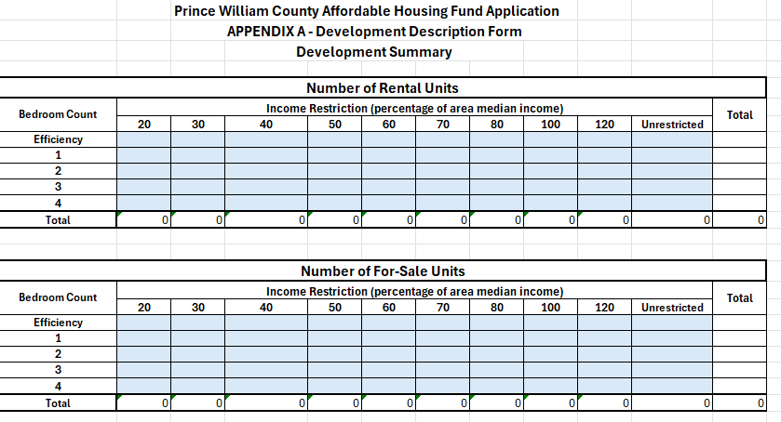
Affordable Housing Fund
Appendix A
Development Summary

Slide 24
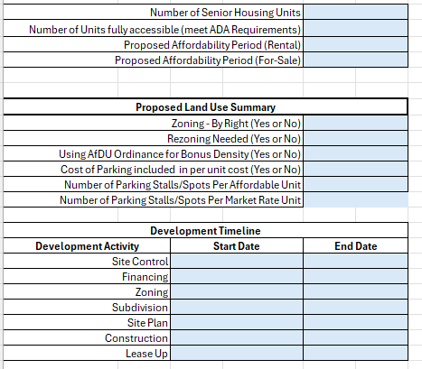
Affordable Housing Fund
Appendix A
Development Summary

Slide 25
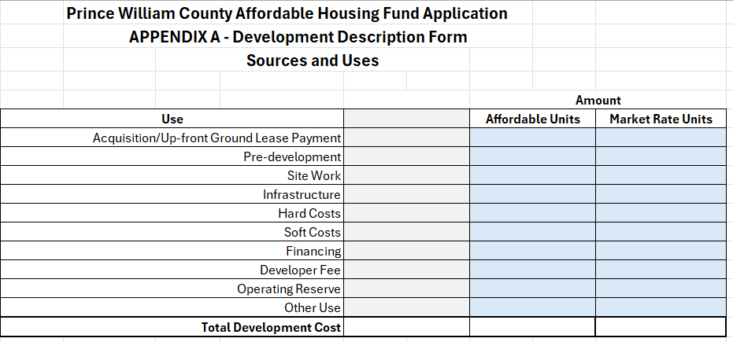
Affordable Housing Fund
Appendix A
Sources & Uses

Slide 26
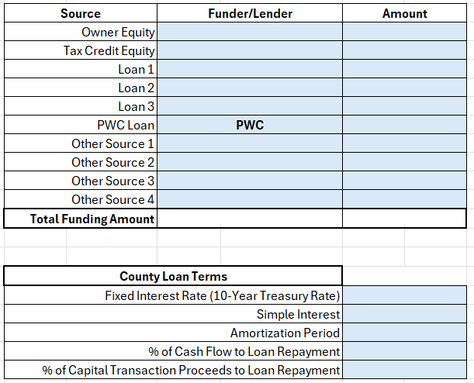
Affordable Housing Fund
Appendix A
Sources & Uses

Slide 27
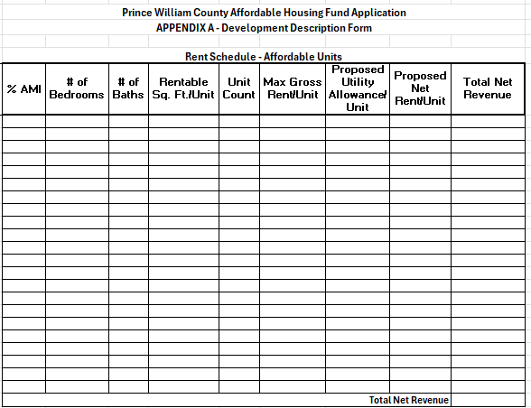
Affordable Housing Fund
Appendix A
Rent Schedule – Affordable Units

Slide 28
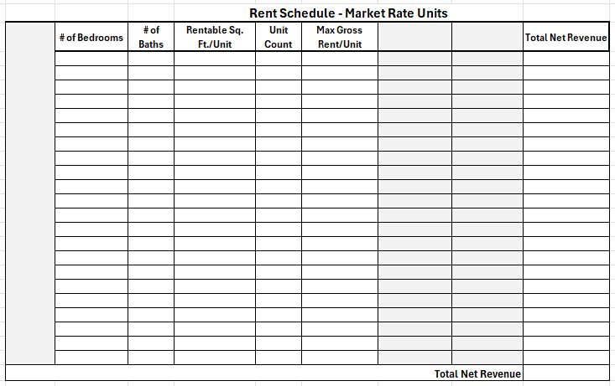
Affordable Housing Fund
Appendix A
Rent Schedule – Market Rate Units

Slide 29
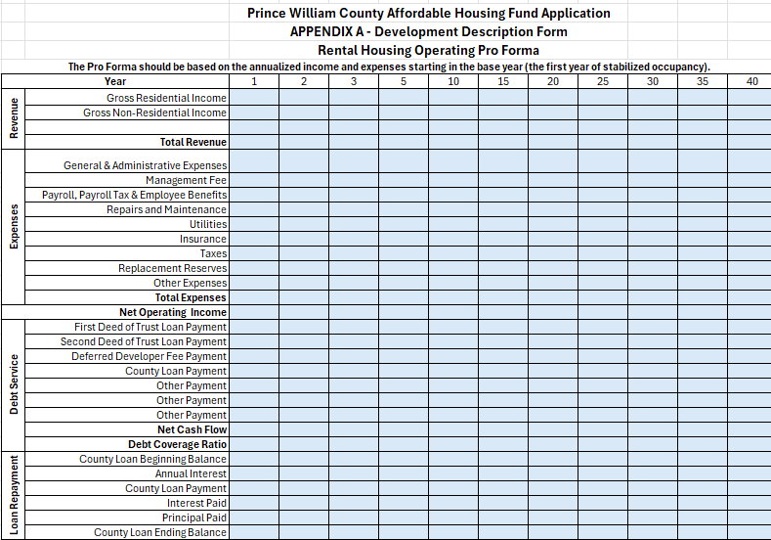
Affordable Housing Fund
Appendix A
Rental Pro Forma

Slide 30
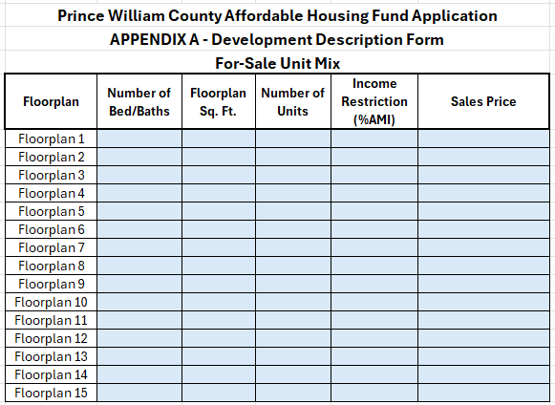
Affordable Housing Fund
Appendix A
For-Sale Unit Mix

Slide 31
Affordable Housing Fund
Application Process/Timeline FY27
March 11 May 1 July 1 September October
1
2
3
4
5
Pre-Application meeting
NOFA Release
Application Submission Deadline
OHCD Final Review
Announcement of Award(s)

Slide 32
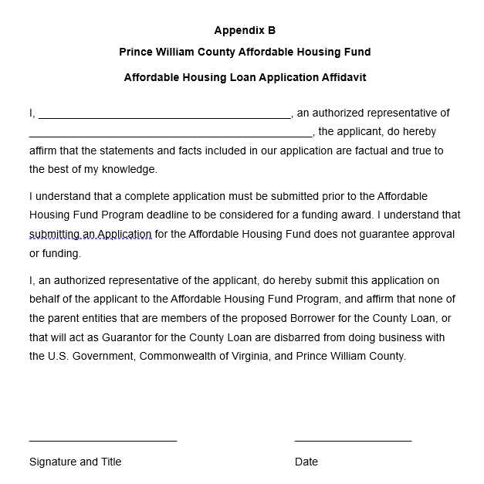
Loan Application Affidavit
Guidelines Pages 17-19

Slide 33
Anticipated NOFA Checklist - Slide 1 of 7
Item | Provided Check if “Yes”
One original and one copy signed and dated. The application will be submitted through the OHCD portal using the process identified in the NOFA. | ☐
Summary of facts that explain how this project will rehabilitate, construct, and/or preserve the greatest number and highest quality of price restricted or market affordable housing units to serve the County’s households at the greatest need in the most economically sustainable way. At a minimum, the summary statement shall include whether and how the development (i) meets the transportation needs of residents, (ii) how internet connection needs are met (whether broadband will be provided, the type and coverage and its costs— including estimates of costs on the operating expenses side), and (iii) what common facilities and other amenities are available on-site and in the larger market-rate development, if applicable, and its cost. | ☐
Signed loan application affidavit. | ☐
$500 non-refundable loan application fee (or the amount approved by the Board of County Supervisors) | ☐
Organizational chart for each loan applicant. The chart should show the name and title for each loan applicant’s principals, executive officers, and key project staff. The chart should identify the ownership structure and identify the percentage of interest of each owner. Nonprofit organizations should submit an organizational chart that identifies board members, directors, officers, and executives of the organization. | ☐

Slide 34
Anticipated NOFA Checklist - Slide 2 of 7
Organizational chart for the project developer. The chart should show the name and title for the developer’s principals, executive officers, and key project staff. The chart should identify the developer’s ownership structure and identify the percentage of interest of each owner. Nonprofit organizations should submit an organizational chart that identifies board members, directors, officers, and executives of the organization. | ☐
Organizational chart for the proposed affordable housing project management. The chart should show the name and title for the affordable housing project management’s principals, executive officers, and key project staff. The chart should identify the affordable housing project management’s ownership structure and identify the percentage of interest of each owner. | ☐
One page resume for each of the principals, executive officers, and key project staff listed in response to numbers 5, 6, and 7. The resume should include current responsibilities and past relevant experience. | ☐
Operating agreement, partnership agreement, or corporate charter of loan applicant. | ☐
Disclosure of each principal’s (named in the above organizational charts) participation in previous or same year affordable housing applications or projects within or outside the County, including the status of those projects, the demographic to be served, and support services provided, if any. In the case of non-profit organizations, provide brief, but substantive, information about its mission or purpose, population served, and a summary of existing projects or programs developed/administered by the organization, including any previous experience in Prince William County. | ☐

Slide 35
Anticipated NOFA Checklist - Slide 3 of 7
Virginia State Corporation Commission’s certification of good standing of loan applicant, developer, and property manager entities. If a single purpose entity is the owner, certificate of good standing of the member(s), manager (s), managing member(s), shareholder(s), or partner(s) of such entity, as applicable; section 501 (c)(3) Determination Letter, if a non-profit organization. | ☐
Applicant’s financial statements as required to be submitted or already submitted to federal and state programs with analysis of the organization’s financial position and its ability to support the project for which AHF funds are requested, with indicators of how the submitted financial statements support the proposition that the organization is/will be able to support the project. | ☐
Letter from each loan applicant and developer certifying that no principal, member of the executive leadership team, or member of the board of directors (if applicable) has been debarred from participation in any federal, state, or local program and certifying that no principal, member of the executive leadership team, or member of the board of directors (if applicable) has any unresolved default or noncompliance issues with Prince William County, the Commonwealth of Virginia, or the United States Government. | ☐
Purchase listing, listing, bid notification, and/or site control documentation. For acquisitions of land or structures, provide all documentation regarding the ownership and physical control of the property that will be the subject of the funding, including but not limited to option to purchase, sales contract, sales listings and addenda, required documents for other federal and state funding programs, bid notification for auctioned properties, etc. | ☐

Slide 36
Anticipated NOFA Checklist - Slide 4 of 7
A summary description of the project’s location including the immediate neighborhood, civic associations, or condominium, as applicable and the context of other development/uses in the adjacent area; Community Amenities and Services available near the project such as parks, walking and biking trails, public pools, activity centers, public library, and career/business centers, the distance of those amenities from the site, including access to public transit; land acquisition cost by acre and square foot (including discount by the seller, if any), as well as explanation of other costs, besides vacant land acquisition (e.g. improvements, proffers, utilities, infrastructure), that has been included within the bid or agreed upon purchase price for the site, if any, with evidence to support such additional costs. The location information shall include: a photo of the site, a map showing street names, if the property is served by transit currently, how far away is the closest current transit stop, existing address or closest key intersections (if the property has no current mailing address), census tract (s) of the proposed development, and census tract data to include income levels, poverty levels and household composition data, and plans to address transportation needs of residents. | ☐
Environmental site assessment. | ☐
Documentation of land use approval for the proposed development, as by right, Board approved rezoning, or a Board approved special use permit, including any approved proffers and/or SUP conditions. | ☐
Relocation assistance plan for existing and occupied buildings resulting in the displacement of current occupants, if applicable. | ☐

Slide 37
Anticipated NOFA Checklist - Slide 5 of 7
Project development budget in the form of sources and uses of funds (provided in Excel format), and proposed project schedule. The full project development budget should include the financing sources with itemized amounts (federal, state, and private entities), status of commitment, timing and intended use of all the sources, as well as known acquisition costs, construction/rehabilitation cost, contingencies and all anticipated financing and soft cost (professional/legal/appraisal fees, architectural and engineering fees, construction loan interest, developer fees, marketing costs, real estate taxes, insurance costs, any loan or financing fees, building permit costs, anticipated relocation expenses and consultant fees) calculated on an aggregate, per unit and square foot basis, both with respect to the total financing sources available and with respect to the County loan. Any item, including contingencies, with a cost of $10,000 or higher should be individually identified in the development budget. The total amount budgeted for contingencies needs to be shown as well. This section of the application should also include a list of other funding sources the developer has applied for or plans to apply for this development, whether those applications were submitted or will be submitted, as applicable, as well as estimated time for their approval or rejection. The proposed project schedule shall include predevelopment, site control, development site approval (with enumeration of any known or potential challenges to development of the site), financing milestones (including use of sources received) and if applicable, construction milestones through completion, occupancy and lease up. | ☐
Thirty-year operating pro forma, as applicable, including aggregate and per unit amounts) (provided in Excel format). For rental projects, the pro forma should include at a minimum: rental revenues and ancillary income, as well as expenses such as market vacancy; operating and management costs (e.g. cost/expenses associated with support services including permanent supportive housing units provided at the site and cost of broadband); real estate taxes; all fees the applicant expects to pay from the operating budget reserves for operating deficits (operating reserves) and any contingency amount, lease up and future capital expenses, including the capital replacement reserve; developer’s and other fees and amount of the deferred fees; reserve for replacement deposits; hard debt service; the term required to fully repay the County’s loan; methodology used/to be used during the life of the County’s loan for calculating cash flow to repay such loan, as well as waterfall for distribution/disbursement of such cash flow. Any item, including contingencies, for an amount of $10,000 or higher should be individually identified in the operating pro forma. | ☐

Slide 38
Anticipated NOFA Checklist - Slide 6 of 7
Tax credit calculations, if applicable (provided in Excel format). | ☐
Letters of intent or interest for all funding sources identified in the loan application, if applicable. At a minimum, a narrative of all proposed funding sources, amounts and status of the application must be provided. | ☐
Loan applications proposing projects developed using the LIHTC, HUD 221(d)(4) Affordable and/or other federal or state program must present a plan for the project that addresses the after-the-initial 15 year compliance period, which clearly describes the exit strategy for the limited partner and anticipated ownership changes; any anticipated refinancing, re-syndication, or sale to a third party; and how affordability will be maintained through the extended affordability period. | ☐
Factual or documentary evidence to support factual description of the type of support services and programs the applicant is proposing for the project, its estimated operational costs, and how those costs will be supported. The applicant has provided a detailed plan for managing and delivering support services to special needs populations. | ☐
Documentary evidence to support that common amenities offered to residents of the master development where the affordable housing project will be located will be available to the residents of the affordable housing project at no additional cost to such residents. (No additional charges over and above the normal fees charged for all the development residents). | ☐

Slide 39
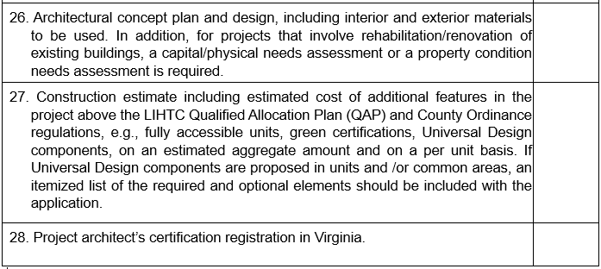
Anticipated NOFA Checklist - Slide 7 of 7

Slide 40
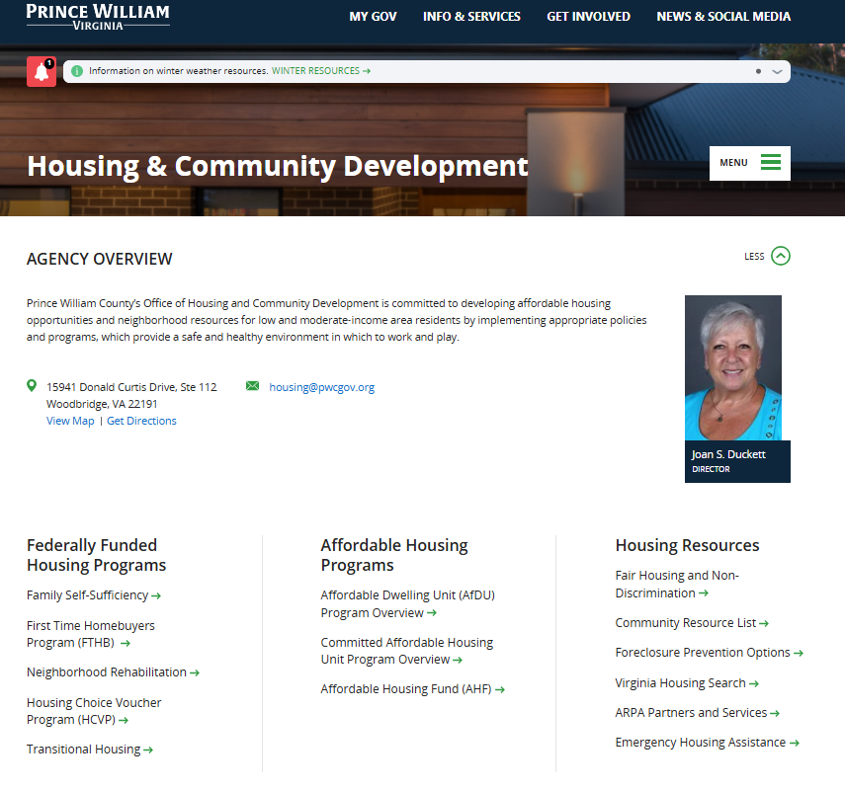
Affordable Housing Fund
Application Submission

Slide 41
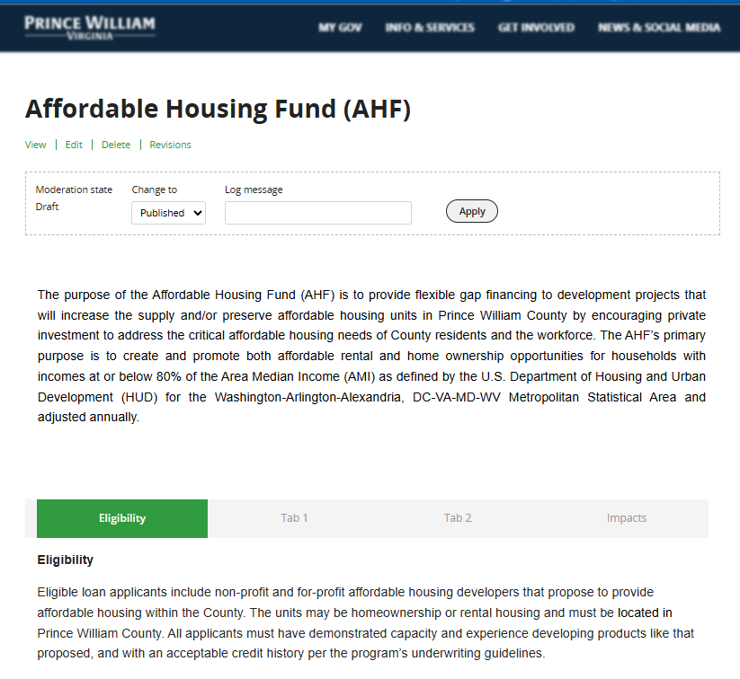
Affordable Housing Fund
Application Submission

Slide 42
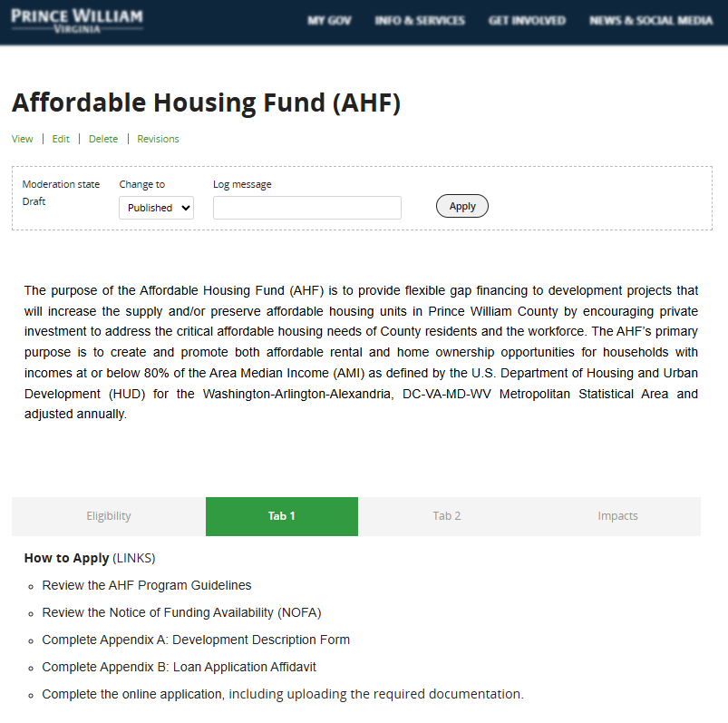
Affordable Housing Fund
Application Submission

Slide 43
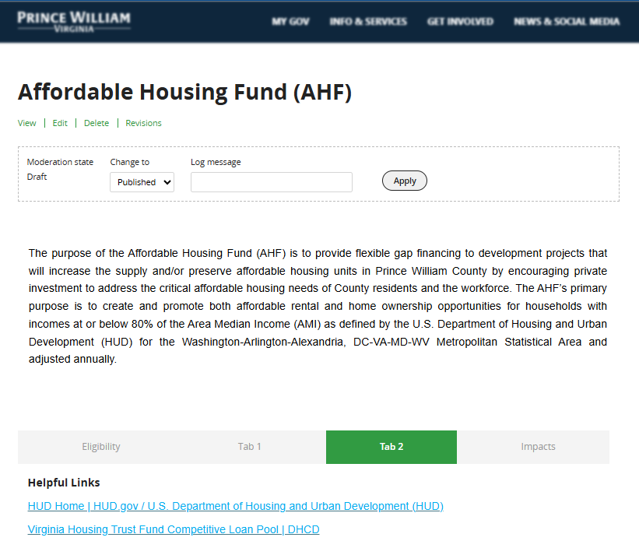
Affordable Housing Fund
Application Submission

Slide 44
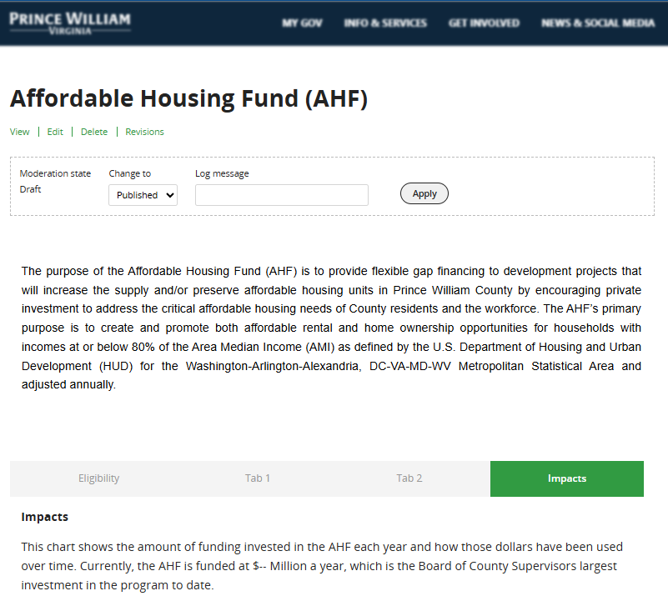
Affordable Housing Fund
Application Submission

Slide 45
Affordable Housing Programs
FAQ Sheets
www.pwcva.gov/housing
FAQ Sheet
Notes:
Time Allotted: .5 minutes
Objective(s):
Share background and intent for FAQ sheet
Share where/how this resource is available

Slide 46
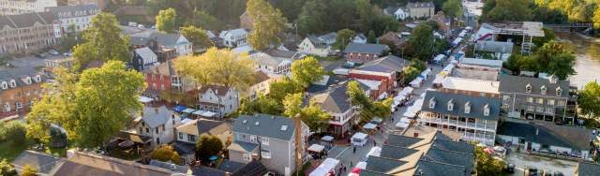
Contact Information
Prince William County Affordable Housing Fund
Joan S. Duckett
Director of Housing
Office: 703.792-7539
jduckett@pwcgov.org
Ivette Monney
Sr. Housing Program Manager
Office: 703-792-3969
Imonney@pwcgov.org
www.pwcva.gov/housing

Slide 47



Let’s Chat!
QUESTIONS
ANSWERS
Notes:
Time Allotted: 25 minutes
Objective(s):
Record questions asked/answered
Notate actions for follow-up

