Slide 1

Affordable Housing Fund (AHF)
Program Introduction
February 25, 2026

Slide 2
Agenda
What We Will Discuss
• Overview of Affordable Dwelling Unit Ordinance (AfDU)
• Overview Rezonings – Comp Plan or AfDU Ordinance
• Affordable Housing Fund (AHF)
• Program Priorities & Eligible Uses of AHF Funds
• AHF Funding Requirements & Loan Terms
• AHF Application Process and Timeline
• AHF Overview of Scoring Criteria

Slide 3
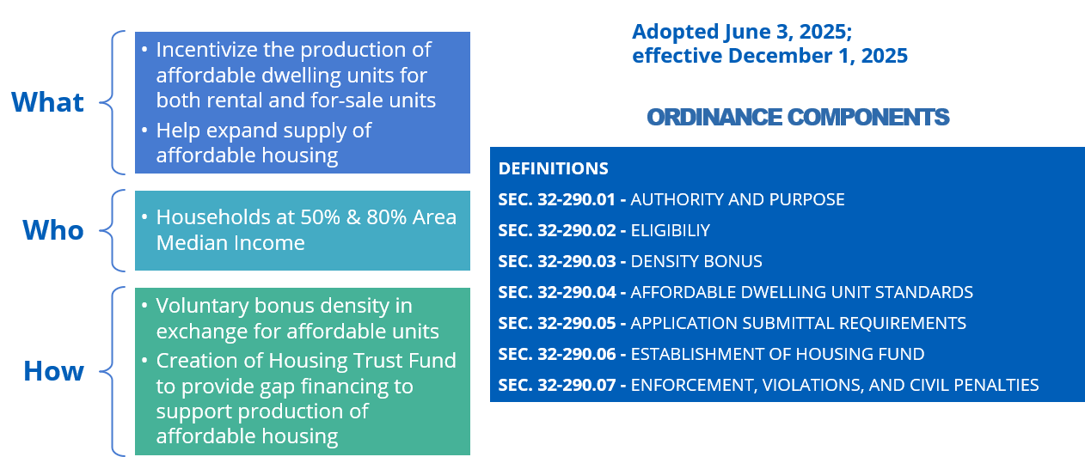
Overview PWC Affordable Dwelling Unit (AfDU) Ordinance

Slide 4
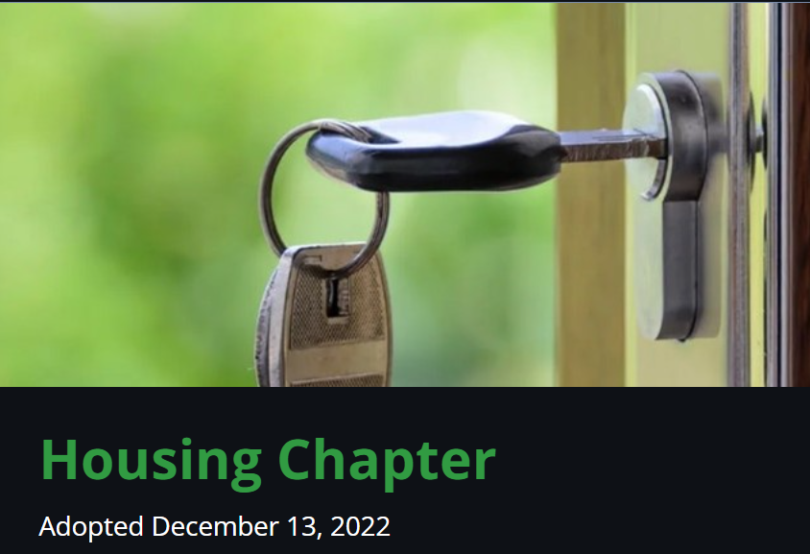
Guidelines for Rezonings
Comp Plan or AfDU Ordinance
Rezonings could choose either
Comp Plan guidelines or AfDU Ordinance
as basis to voluntarily proffer affordable units
2040 Comprehensive Plan
Affordable Housing Supplement
Recommends bonus density 2x the percentage of affordable/workforce units
(Ex. 10% of units offered = 20% bonus density)
Provides more bonus density for 80% AMI to 120% AMI (above 10% of units) compared to AfDU Ordinance
No guidance for 50% to <=80% AMI

Slide 5

Guidelines for Rezonings
Comp Plan or AfDU Ordinance
AfDU Ordinance
For 50% AMI: 5% to 35+% of units offered = 20% to 95% maximum bonus density
For 80% AMI: 10% to 35+% of units offered = 20% to 57.5% maximum bonus density
More bonus density for 50% AMI compared to
Comp Plan
Does not apply above 80% AMI

Slide 6
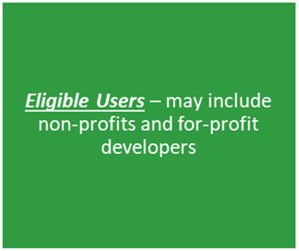
Affordable Housing Fund (AHF)
The Purpose –Affordable Housing Trust Fund is to provide flexible gap financing to development projects that will increase the supply and/or preserve affordable housing units in Prince William County
Income Range – The Affordable Housing Trust Fund will aid in meeting the housing needs of very low-income (households with incomes that do not exceed 50% AMI) and low-income (households with incomes that do not exceed 80% AMI)
Form of Assistance – Take the form of low-interest loans
Housing Fund – BOCS has currently allocated $14.5M to the Housing Trust Fund with a budget of $31M by FY29

Slide 7
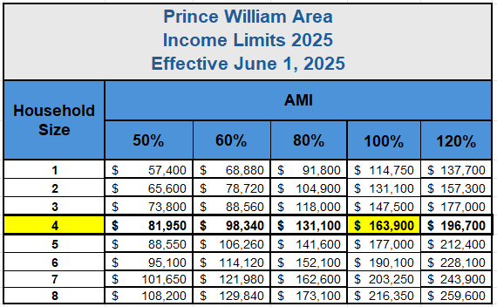
Area Median Income & Income Limits

Slide 8
Affordable Housing Fund (AHF) Project Types
Types of Projects
Multi-family affordable rental housing units in the County developed pursuant to federal and state programs such as the Virginia Low Income Housing Tax Credit (LIHTC)
Acquisition of naturally occurring below-market affordable housing to preserve existing affordable housing units
Acquisition of affordable rental housing in danger of being converted to market rate
Construction of affordable units, which refers to new housing structures
Real estate acquisition is directly linked to construction, or rehabilitation of rental and/or homeownership affordable units
Rehabilitation/renovation of affordable units
Future Consideration for Project(s)
Through a certified Land Trust, implement a land banking strategy designed to build a sustainable fund over the next 5-10 years
Shared equity program/third party purchase of foreclosed housing and low-cost housing units
Consideration of rent buydown/rental assistance program

Slide 9
Affordable Housing Fund (AHF) Uses
Eligible Uses
Construction, rehabilitation and preservation of housing in the County and related costs for affordable rental and owner-occupied housing.
Ineligible Uses
Operating expenses
Social services
Project reserves, except if required by Virginia housing or HUD
Hard or soft cost contingencies
Developers’ fees
Builder’s profit
Syndication related costs
Construction Management fees
Development/financing consultant fees or fees for other non-development related services, including funding guarantee or reserve accounts required by lenders or investors
Units for rent or sale at market rate
Financing fees

Slide 10
Affordable Housing Fund (AHF)
Loan Provisions
AHF loan will serve as gap financing
Loan Applicants must demonstrate other sources of funding
Affordability period between 15 to 50 years or until the loan is fully repaid, whichever comes later
Rent and mortgage affordability restrictive covenants
AHF loan must be 20% or less of the total non-County funding of the development costs of the housing project
Max loan amount $75,000 per affordable unit for projects serving households with incomes at 50% and up to but not to exceed 80% of Area Median Income limits (AMI)
Max loan amount $100,000 per affordable unit for projects serving households with incomes at or below 50% of AMI
Repayment of the loan amount required, with the length of the loan not to exceed the length of the project affordability period
Should the loan be paid off ahead of schedule the affordability period shall not be shortened, or the affordability covenants will not be released

Slide 11
Affordable Housing Fund Financing Terms
Interest rate will be simple interest at a fixed rate per 10-year Treasury Bill Rate
Amortized with a term not to exceed 30 years (plus one-year period after loan closing for construction / rehabilitation/renovation)
Repayment term not to exceed the length of the project affordability period
Loan commitment term is three (3) years after approval. If the County loan does not close within this period, funds could be reassigned to another project
The applicant may reapply in a subsequent funding cycle using the same loan application for the affordable housing project that was originally approved, subject to funds availability
LIHTC and/or HUD 221(d)(4) Affordable program must present a plan describing:
  Exit strategy for the limited partner and anticipated ownership changes; any anticipated refinancing, re-syndication, or sale to a third party; how affordability will be maintained through the extended affordability period; and measures in place to ensure any future transfer serve the interests /guidelines of the AHF
10

Slide 12
Affordable Housing Fund
Project Submission
Project Requirements for Submission & Review
Annual Competitive Application Process through annual Notice of Funding Availability (NOFA)
Office of Housing & Community Development Affordable Dwelling Unit Division staff will review applications for completeness and initial eligibility
An interdepartmental Housing Application Review team, led by OHCD staff, will review and discuss the applications. The Housing Application Review Team will include at least staff from the OHCD, Planning Office, Office of Management, Budget, Finance Department and Department of Development Services, with consultation with the County Attorney’s Office as needed
Funding decisions will be made based on the merits of each loan application as graded in accordance with the AHF Guidelines scoring criteria, terms contained in the NOFA, and the availability of resources in the AHF
11

Slide 13
Affordable Housing Fund Competitive Application Process
Date | Event
February 25, 2026 | AHF Introduction Meeting
March 2026 | AHF Pre-Application Meeting
May 1, 2026 | NOFA Release
July 1, 2026, 5:00 pm EST | Application Submission Deadline
September 2026 | Final Application(s) Review
October 2026 | Announcement of Award(s)

Slide 14
Affordable Housing Fund
Project Scoring and Requirements
Funding decisions will be made based on the merits of each loan application as graded in accordance with the AHF Guidelines scoring criteria, terms contained in the NOFA, and the availability of resources in the AHF.
Scoring Criteria
Loans may be approved for less than the full amount requested in the loan application, and if multiple projects apply for the AHF, project scores may be used to compare projects.
Highest consideration will be given to loan applications that demonstrate that the project will rehabilitate, construct and/or preserve the greatest number and highest quality affordable units to serve County households at the greatest need in the most economically sustainable way and meet AfDU Ordinance provisions when applicable.

Slide 15
Affordable Housing Fund (AHF)
Scoring Criteria
Category | Maximum Points/Percentage(s)
Affordability Proposal | 35 Points
Financial Proposal | 25 Points
Project Readiness | 8 Points
Experience | 17 Points
Development Concept | 15 Points
Total | 100 Maximum Points

Slide 16
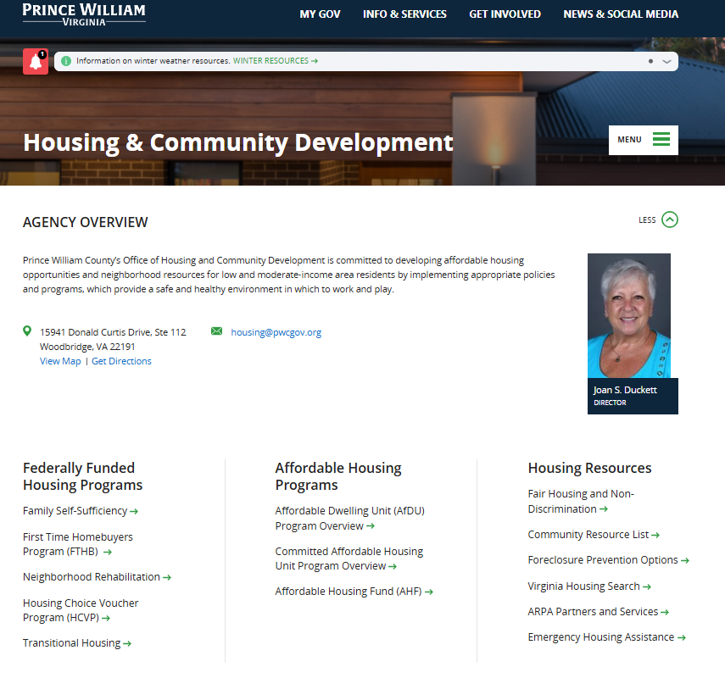
Affordable Housing Programs
FAQ Sheets
www.pwcva.gov/housing
FAQ Sheet

Slide 17

Contact Information
Prince William County Affordable Housing Fund
Joan S. Duckett
Director of Housing
Office: 703.792-7539
jduckett@pwcgov.org
Ivette Monney
Sr. Housing Program Manager
Office: 703-792-3969
Imonney@pwcgov.org
www.pwcva.gov/housing

Slide 18



Let’s Chat!
QUESTIONS
ANSWERS

