Slide 1

“Addressing Neighborhood Parking Dilemmas” or
Can they Park that there?
Officer Mark Merriman, Prince William County Police Department
Steven Stevens, Engineer III, Prince William County Department of Transportation
Paolo Belita, Engineer I, Prince William County Department of Transportation
John Settlemyer, Chief Property Code Enforcement Inspector, Neighborhood Services Division

Slide 2
Parking Regulations Enforcement
Private Property (NSD through Zoning)
Public Streets V.D.O.T. right of way
(Police Agencies - PWC PD)
Private Streets (NSD / PD)*HOA
Design and Planning (VDOT / PWC Department of Transportation)

Slide 3
Code of Virginia
Virginia is a Dillon Rule State
Counties can only create/enforce what the Commonwealth allows them to do.
The Commonwealth has enabled the County to create and enforce Zoning Ordinances, (Chapter 32) Parking Ordinances, (Chapter 13) and other sections within the Prince William County Code.
http://www.municode.com/Library/VA/Prince_William_County

Slide 4
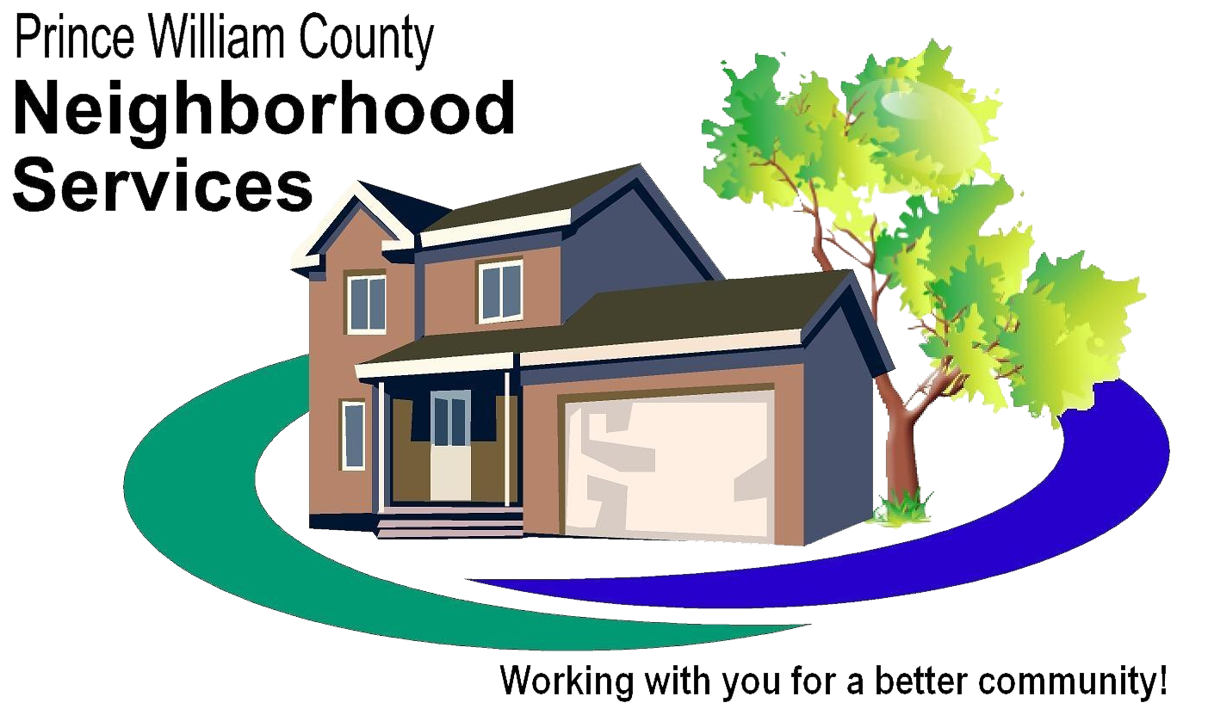
Property Code Enforcement’s Role

Slide 5
Private Property Parking
Regulated primarily through the Zoning Ordinance
  As a Use of the Property
  Chapter 32 of the Prince William County Code
Defined
  Article I of Chapter 32 (Zoning Ordinance)
    Parking
    Motor Vehicles
    Repairs

Slide 6
Inoperative Vehicles are Prohibited
Defined in Article I of Chapter 32
  Not in operating condition;
  60 days or longer has been partially or totally disassembled
  No valid license plate or a valid inspection decal displayed
Four exceptions;
  junk yard, repair, impoundment, screened from view

Slide 7
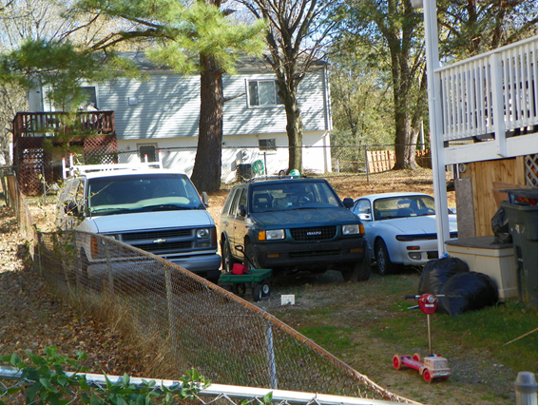
Inoperative Vehicles

Slide 8
Parking on Unimproved Surface
(Parking on Lawn)
Applies only to lots less than one acre
Parked or stored only on areas that are improved
Not to occupy more than 35 percent of or 720 square feet of the minimum required front yard, whichever is greater.

Slide 9
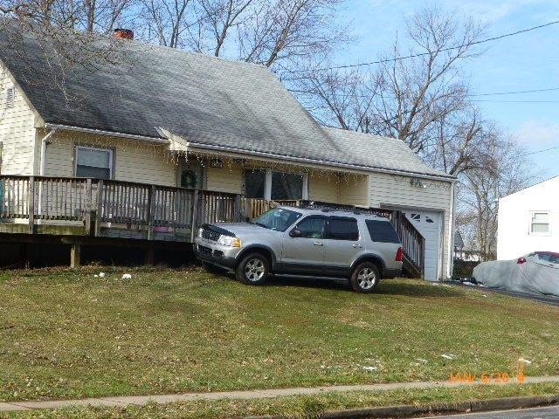
Parking on the Grass

Slide 10
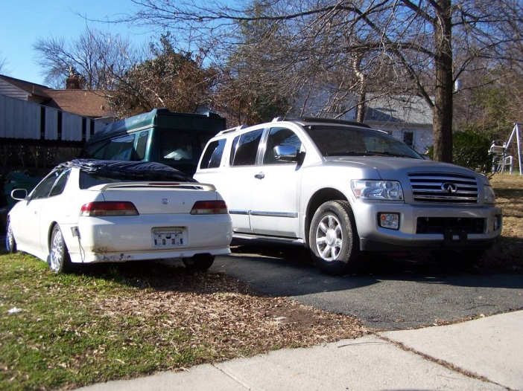
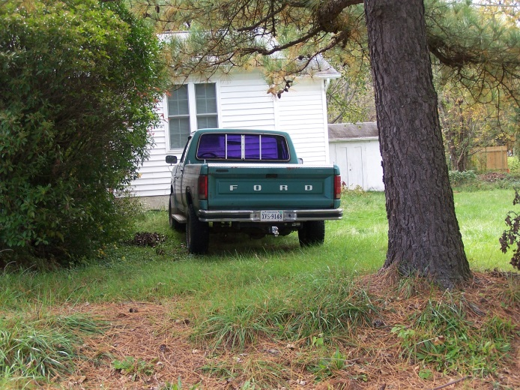
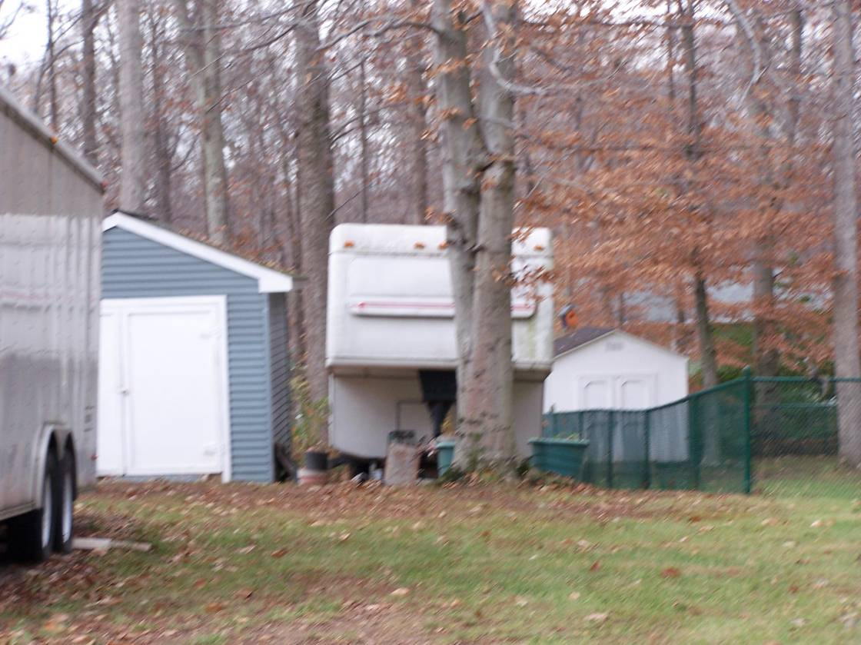
More Parking on the Grass

Slide 11
Prohibited Vehicles
Prohibited vehicles regardless of weight.
  (1) Cement trucks.
  (2) Construction equipment.
  (3) Dump trucks.
  (4) Garbage, refuse or recycling trucks.
  (5) Passenger buses (excluding school buses).
  (6) Tractors or trailers of a tractor-trailer truck.
  (7) Tow trucks.

Slide 12
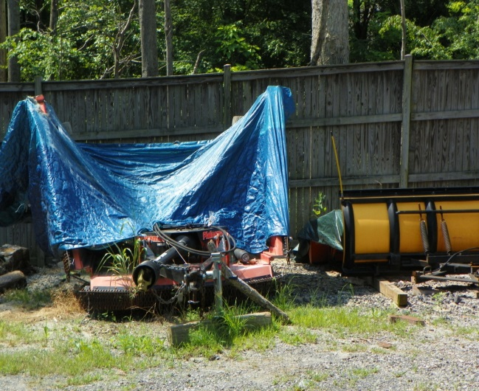
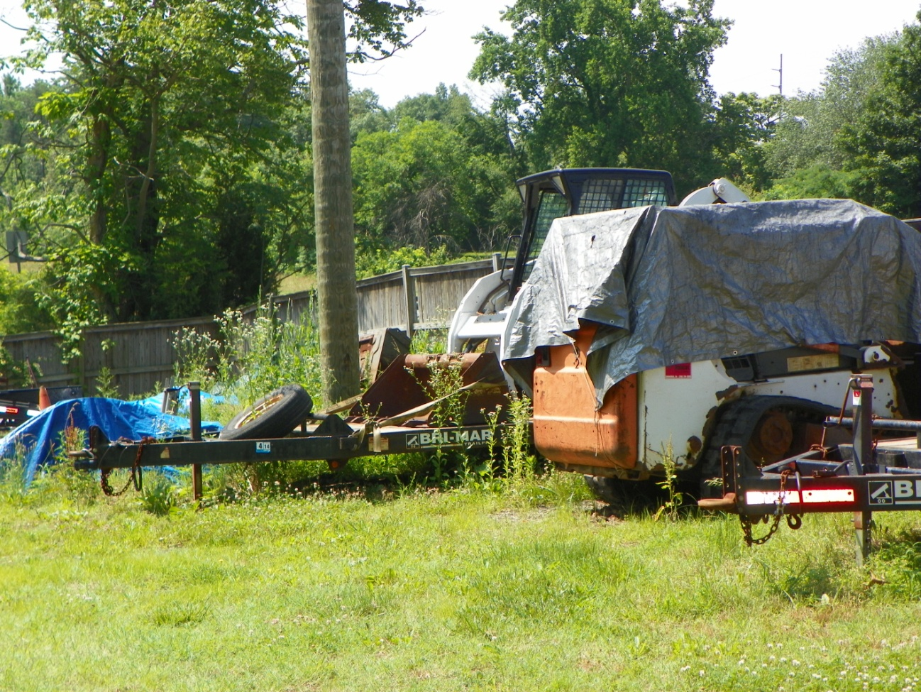
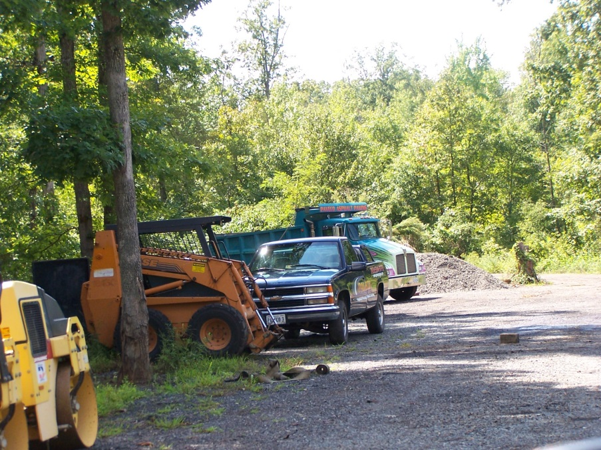
Prohibited Vehicles
Regardless of Weight

Slide 13
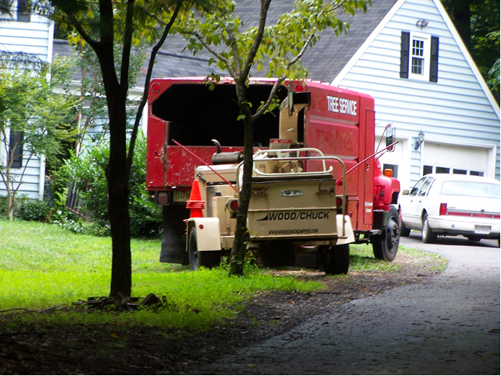
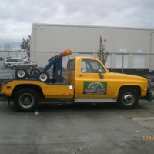

Prohibited Vehicles
Regardless of Weight

Slide 14
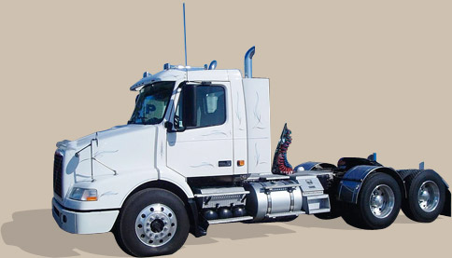
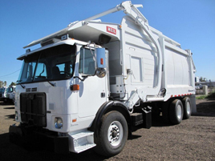
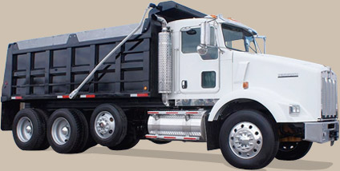
Prohibited Vehicles
Regardless of Weight

Slide 15
Prohibited Vehicles
Gross vehicle weight of 10,100 pounds or more
  (1) Box trucks.
  (2) Flat bed trucks.
  (3) Stake bed trucks.
  (4) Step vans.
  (5) Trailers.

Slide 16
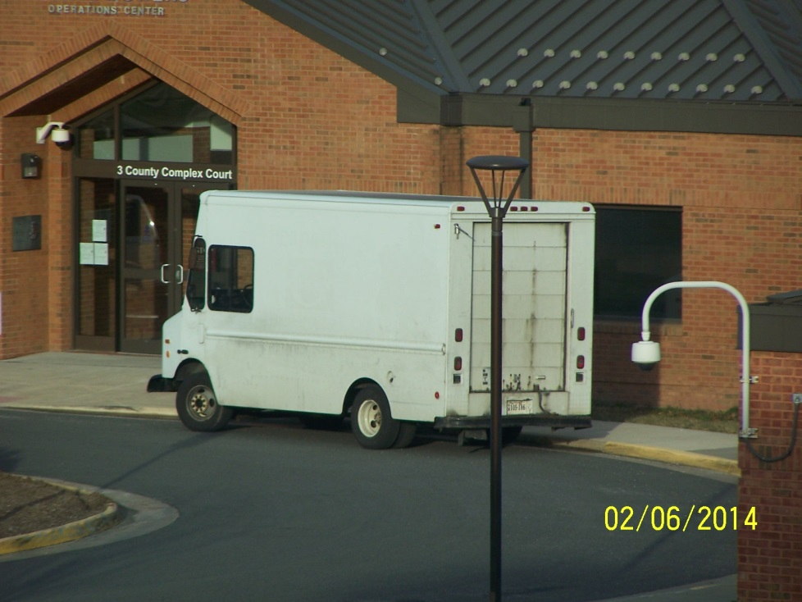
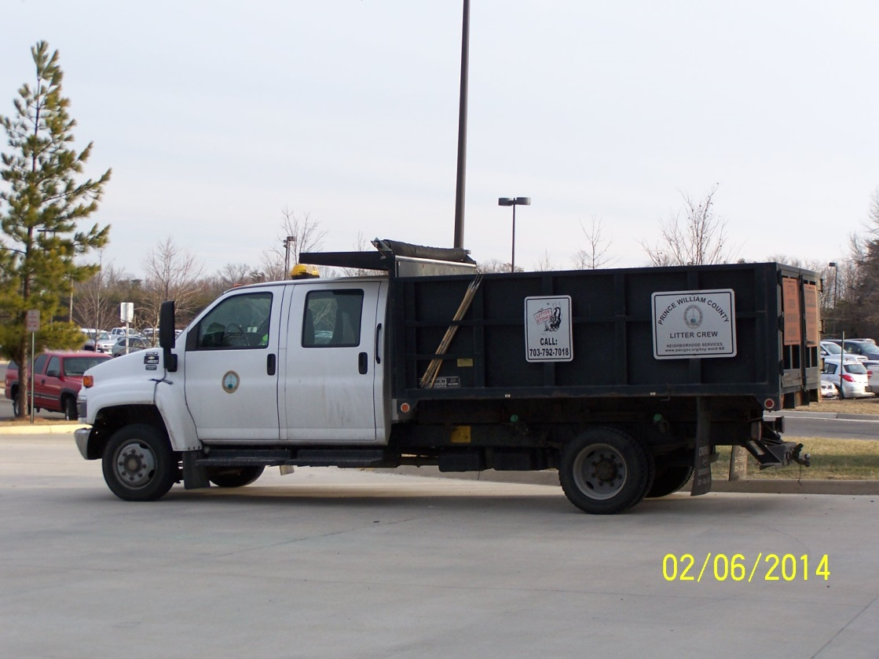
Prohibited Vehicles
If over 10,100 pounds
Step Van
Stake Bed/ Dump Truck

Slide 17
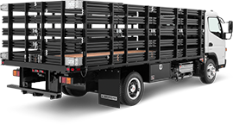
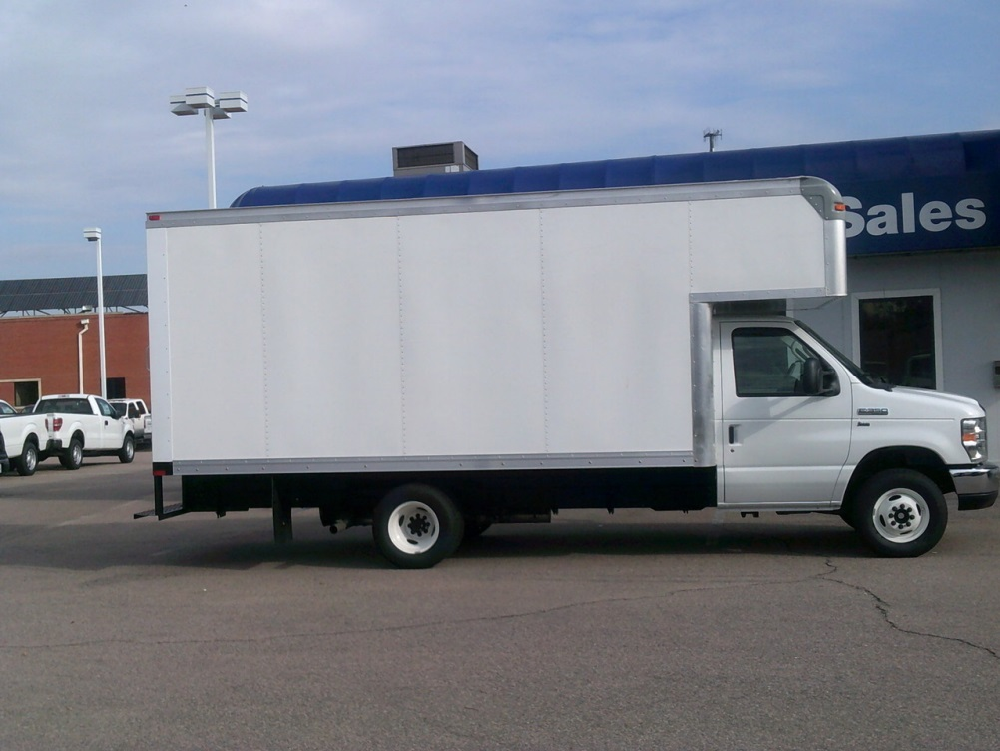
Prohibited Vehicles
If over 10,100 pounds

Slide 18
Commercial Vehicles
10,100 pounds or more
Used for commercial purposes
Any vehicle, regardless of capacity, which displays advertising thereon
Licensed as a "for hire" vehicle, or any limousine used as a common or contract carrier.

Slide 19
Commercial Vehicles
On lots of less than three acres.
Not more than one commercial vehicle
The occupant of the dwelling must be the operator of the vehicle.

Slide 20
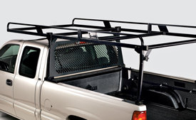
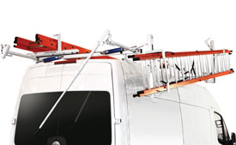
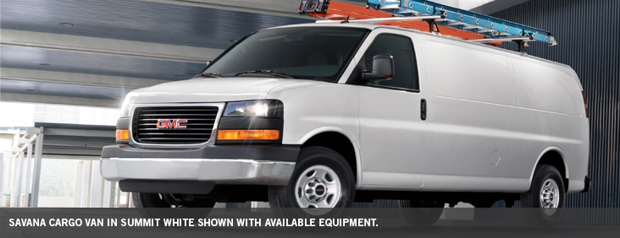
Commercial Vehicles?

Slide 21
Company Vehicles
Passenger motor vehicles or light duty trucks
Less than 7,500 pounds gross vehicle weight
Exclusively used in a business or commercial activity
Shall not include contractor's equipment or other heavy equipment.

Slide 22
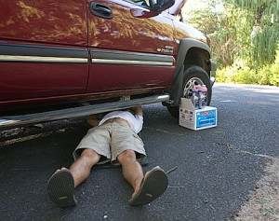
Motor Vehicle Repair
Repair or service of motor vehicles
  in agricultural districts on lots less than ten acres
  in any residential district or residential portion
Titled and registered to the owner and/or occupant or a member of the immediate family of the owner or occupant of the dwelling unit where service or repairs are taking place.

Slide 23
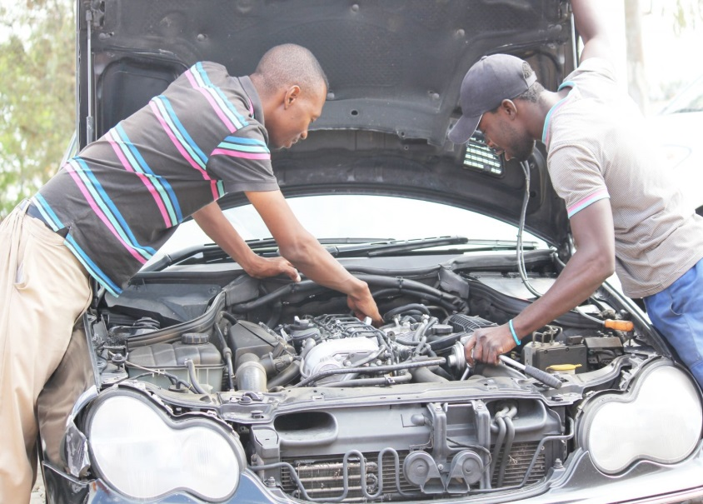
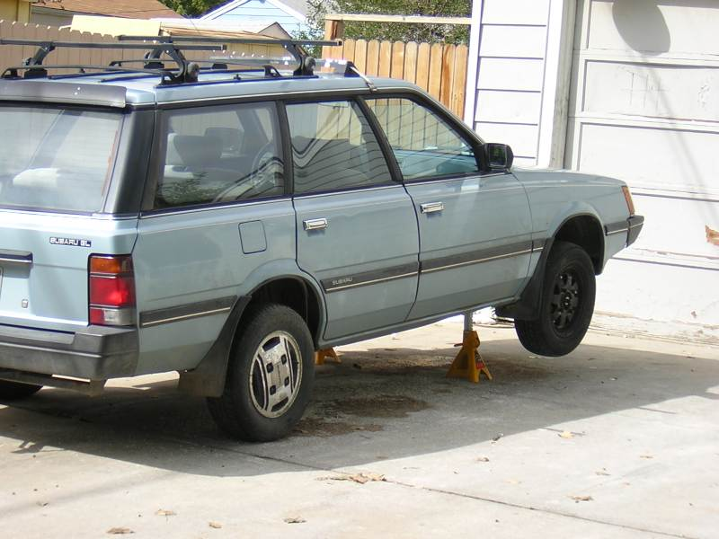
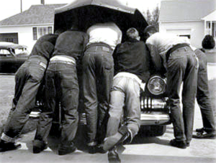
Motor Vehicle Repair

Slide 24
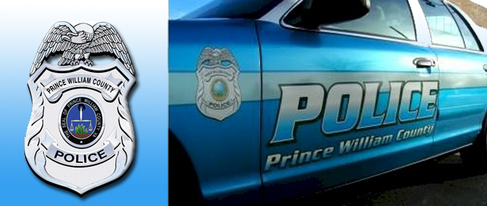
Police Role
Enforce parking ordinances
  Public highways
  Some private roads (13-276 & 277)
    Townhouse Ordinance
  Parking lots of more than 50 spaces (13-278)
    Typically by Parking Enforcement
Ordinances are found in Chapter 13 of the PWC Code

Slide 25
Private Roads
Sec. 13-276. Regulations of traffic and parking in subdivisions employing systems of roadways and parking areas open to the public but not in public ownership.
Sec. 13-277. Designation of certain private roads and private streets and highways for law enforcement purposes.
Sec. 13-278. Regulations of vehicular and pedestrian traffic on certain parking lots open to the public.

Slide 26
Special Notes
Commercial vehicles
Requirement for valid tags & inspection

Slide 27
Inoperative Vehicles
Defined
  Valid tags displayed
  Valid safety inspection
  Operating condition
Exceptions
  Enclosed structure
  Shielded from view

Slide 28
Inoperative Vehicles
Enforcement
  Complaint driven
  Violation Notice
  3 strikes
  Final action

Slide 29
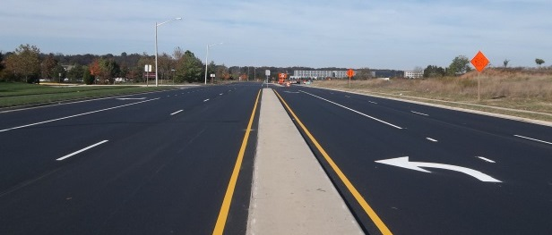
Department of Transportation’s Role

Slide 30
PARKING RESTRICTION
GUIDELINES
February 2014
DEPARTMENT OF TRANSPORTATION
STEVE STEVENS
PAOLO BELITA

Slide 31
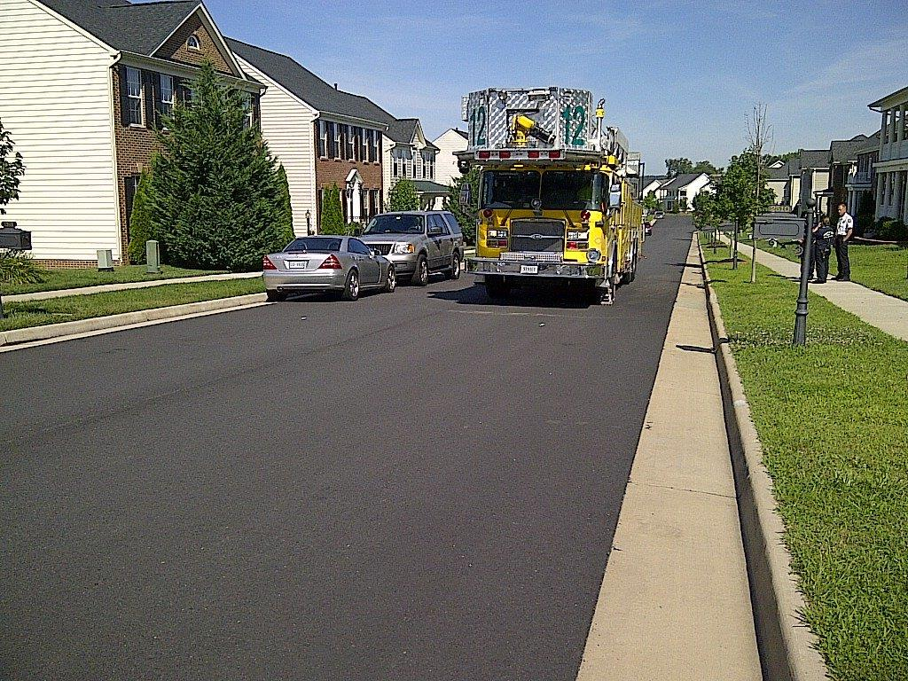
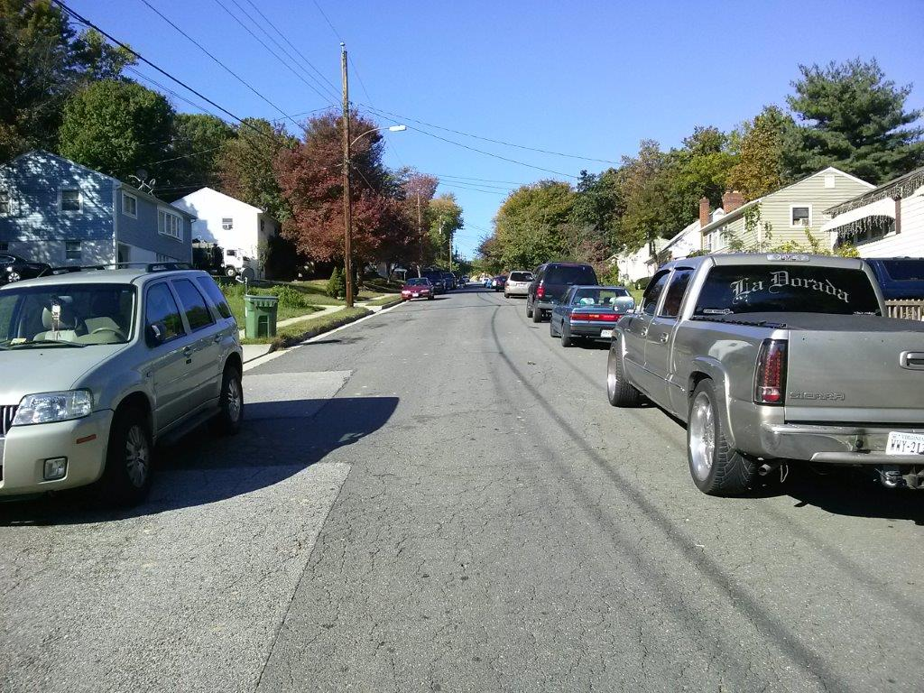
General
The Prince William County Department of Transportation occasionally receives requests for no parking based on roadway widths and concerns that emergency response times may be impacted as a result of on-street parking.
If the road is maintained by VDOT, then a request is made to VDOT Traffic Engineering.
VDOT ultimately makes the determination
if no parking is justified.
The primary reasons for VDOT
to restrict parking are:
  Safety issues – i.e. sight distance obstruction
  for stopped or turning vehicles
  Capacity adversely affected – normal
  traffic flow inhibited by parked vehicles

Slide 32
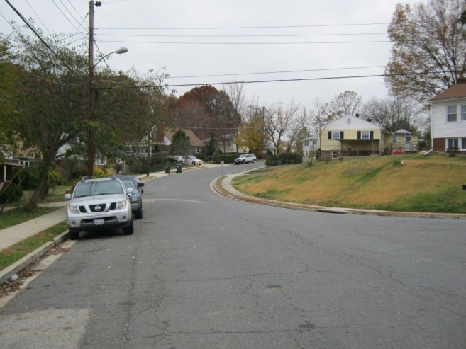
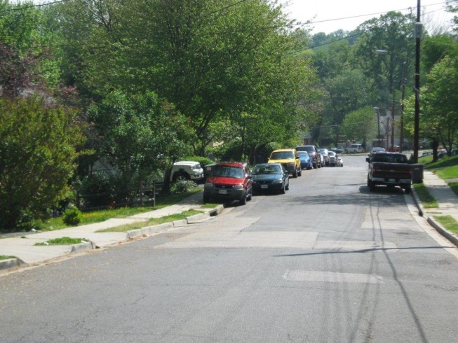
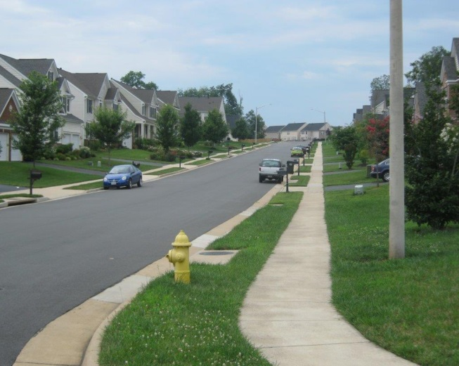
Appeals to PWC DOT
There have been occasions where VDOT has responded that they do not see the need to justify no parking however; they have no objection to Prince William County installing no parking signs on state right-of-way under a permit.
In these cases the requesting entity can appeal to PWC DOT who will coordinate with the appropriate County Supervisor’s office on community support and funding.
Existing Condition Guidelines
CURB TO CURB WIDTH | ONE WAY TRAFFIC | TWO WAY TRAFFIC
29' + | PARKING ON BOTH SIDES | PARKING ON BOTH SIDES
24' TO 28' | PARKING ON ONE SIDE | PARKING ON ONE SIDE
21' TO 23' | PARKING ON ONE SIDE | NO PARKING
20' OR LESS | NO PARKING | NO PARKING

Slide 33
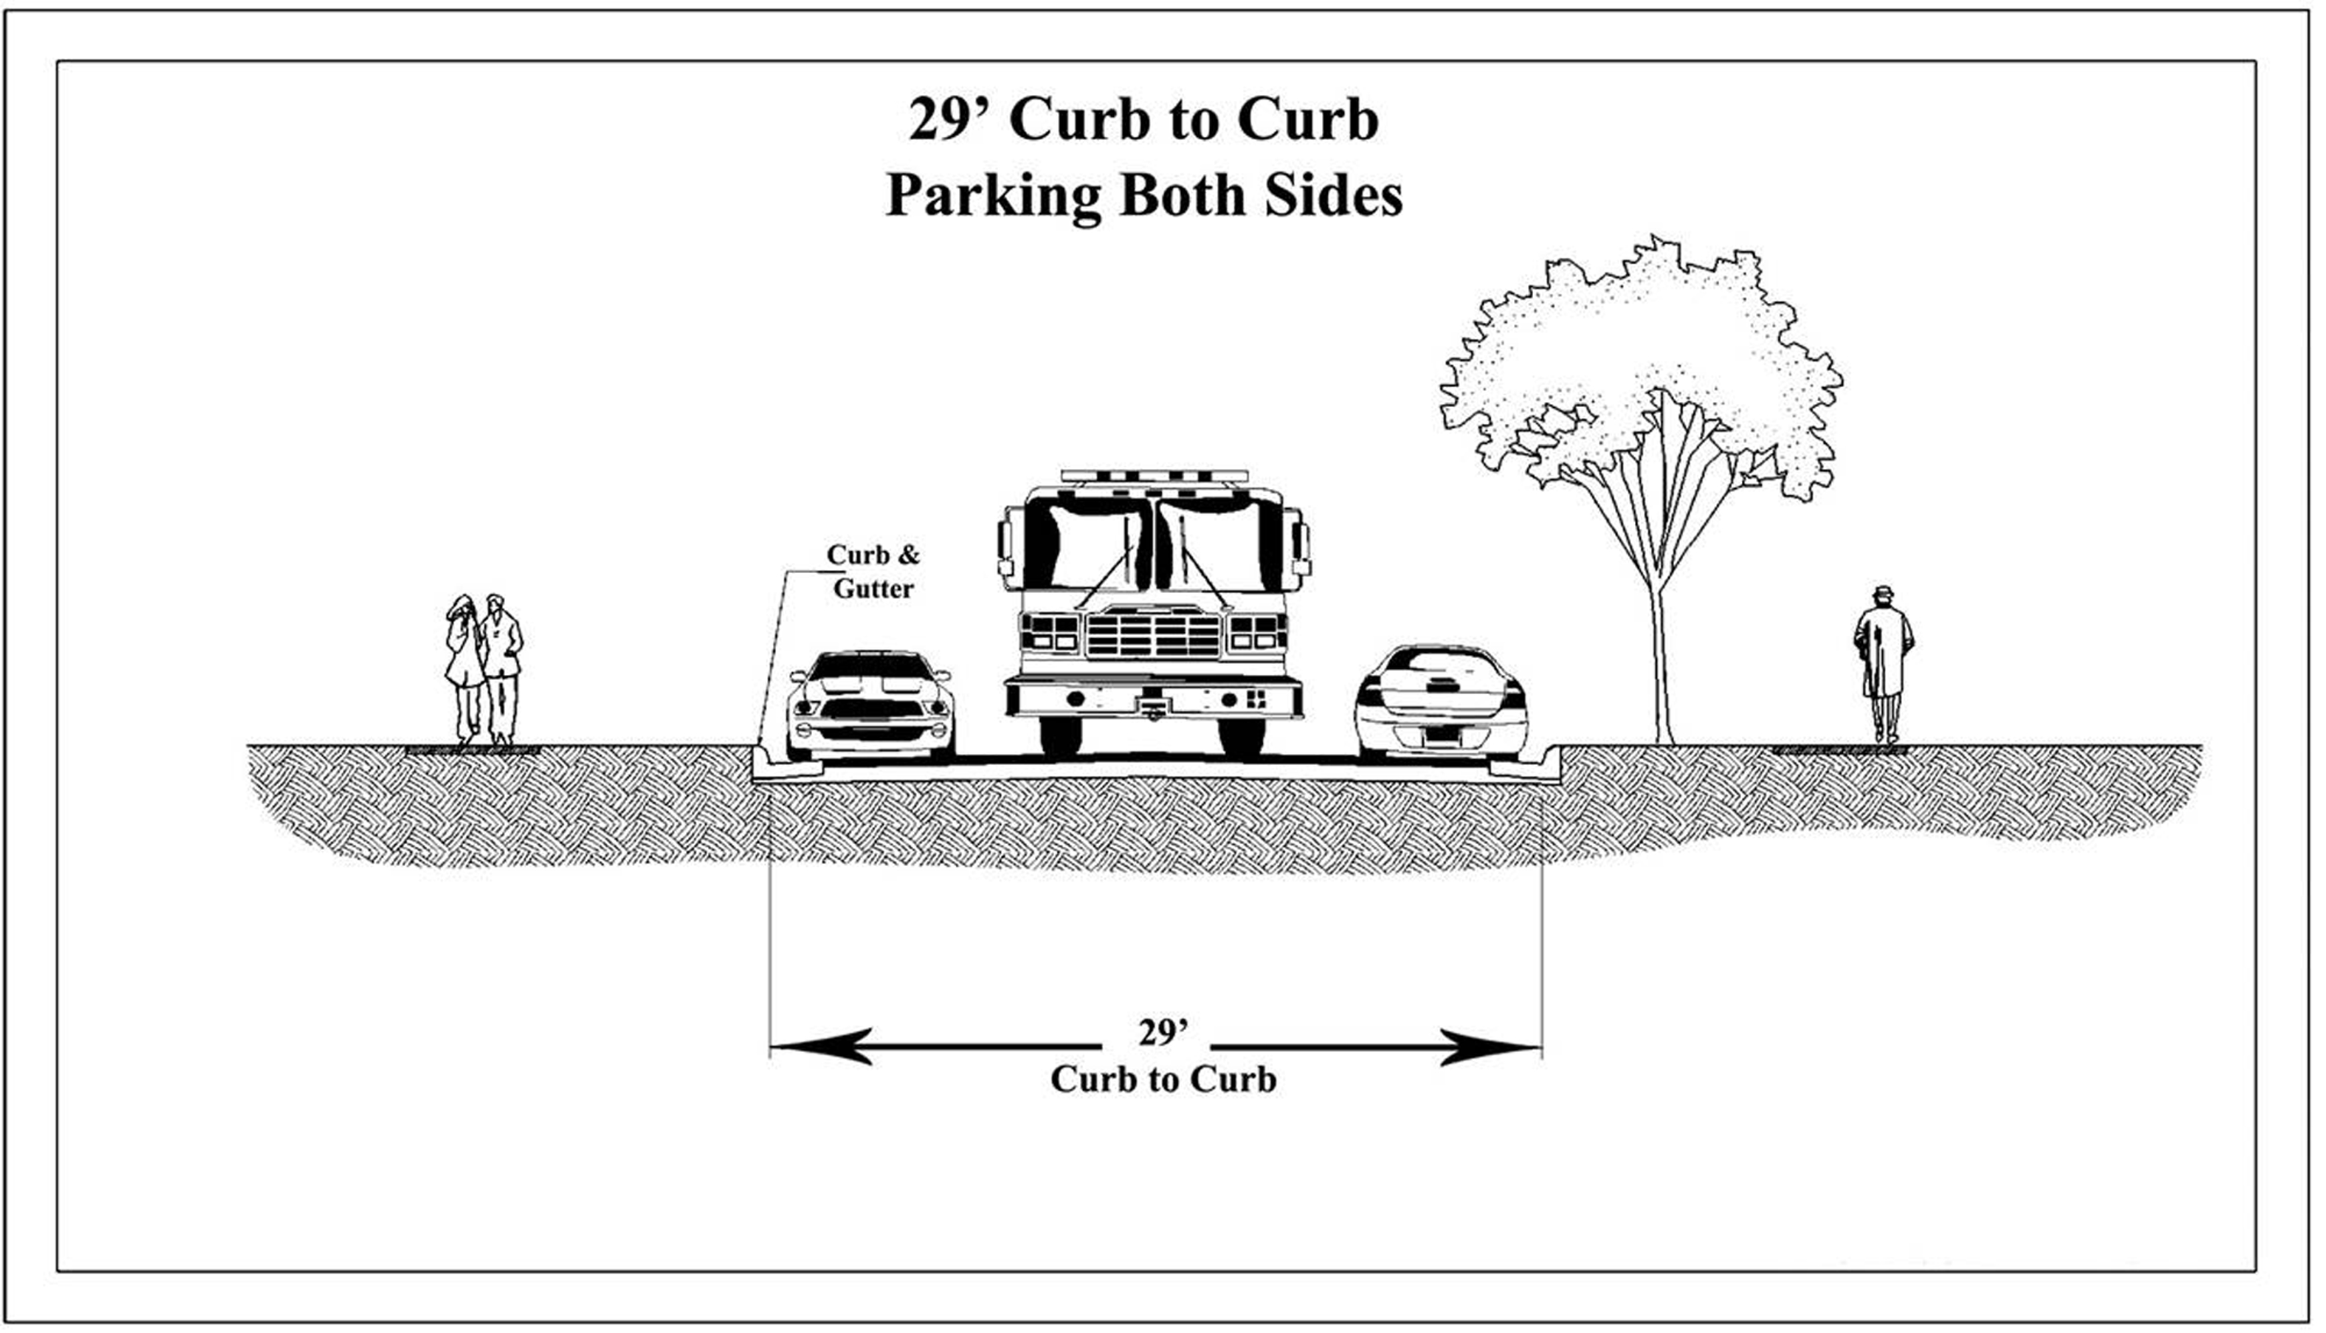

Slide 34
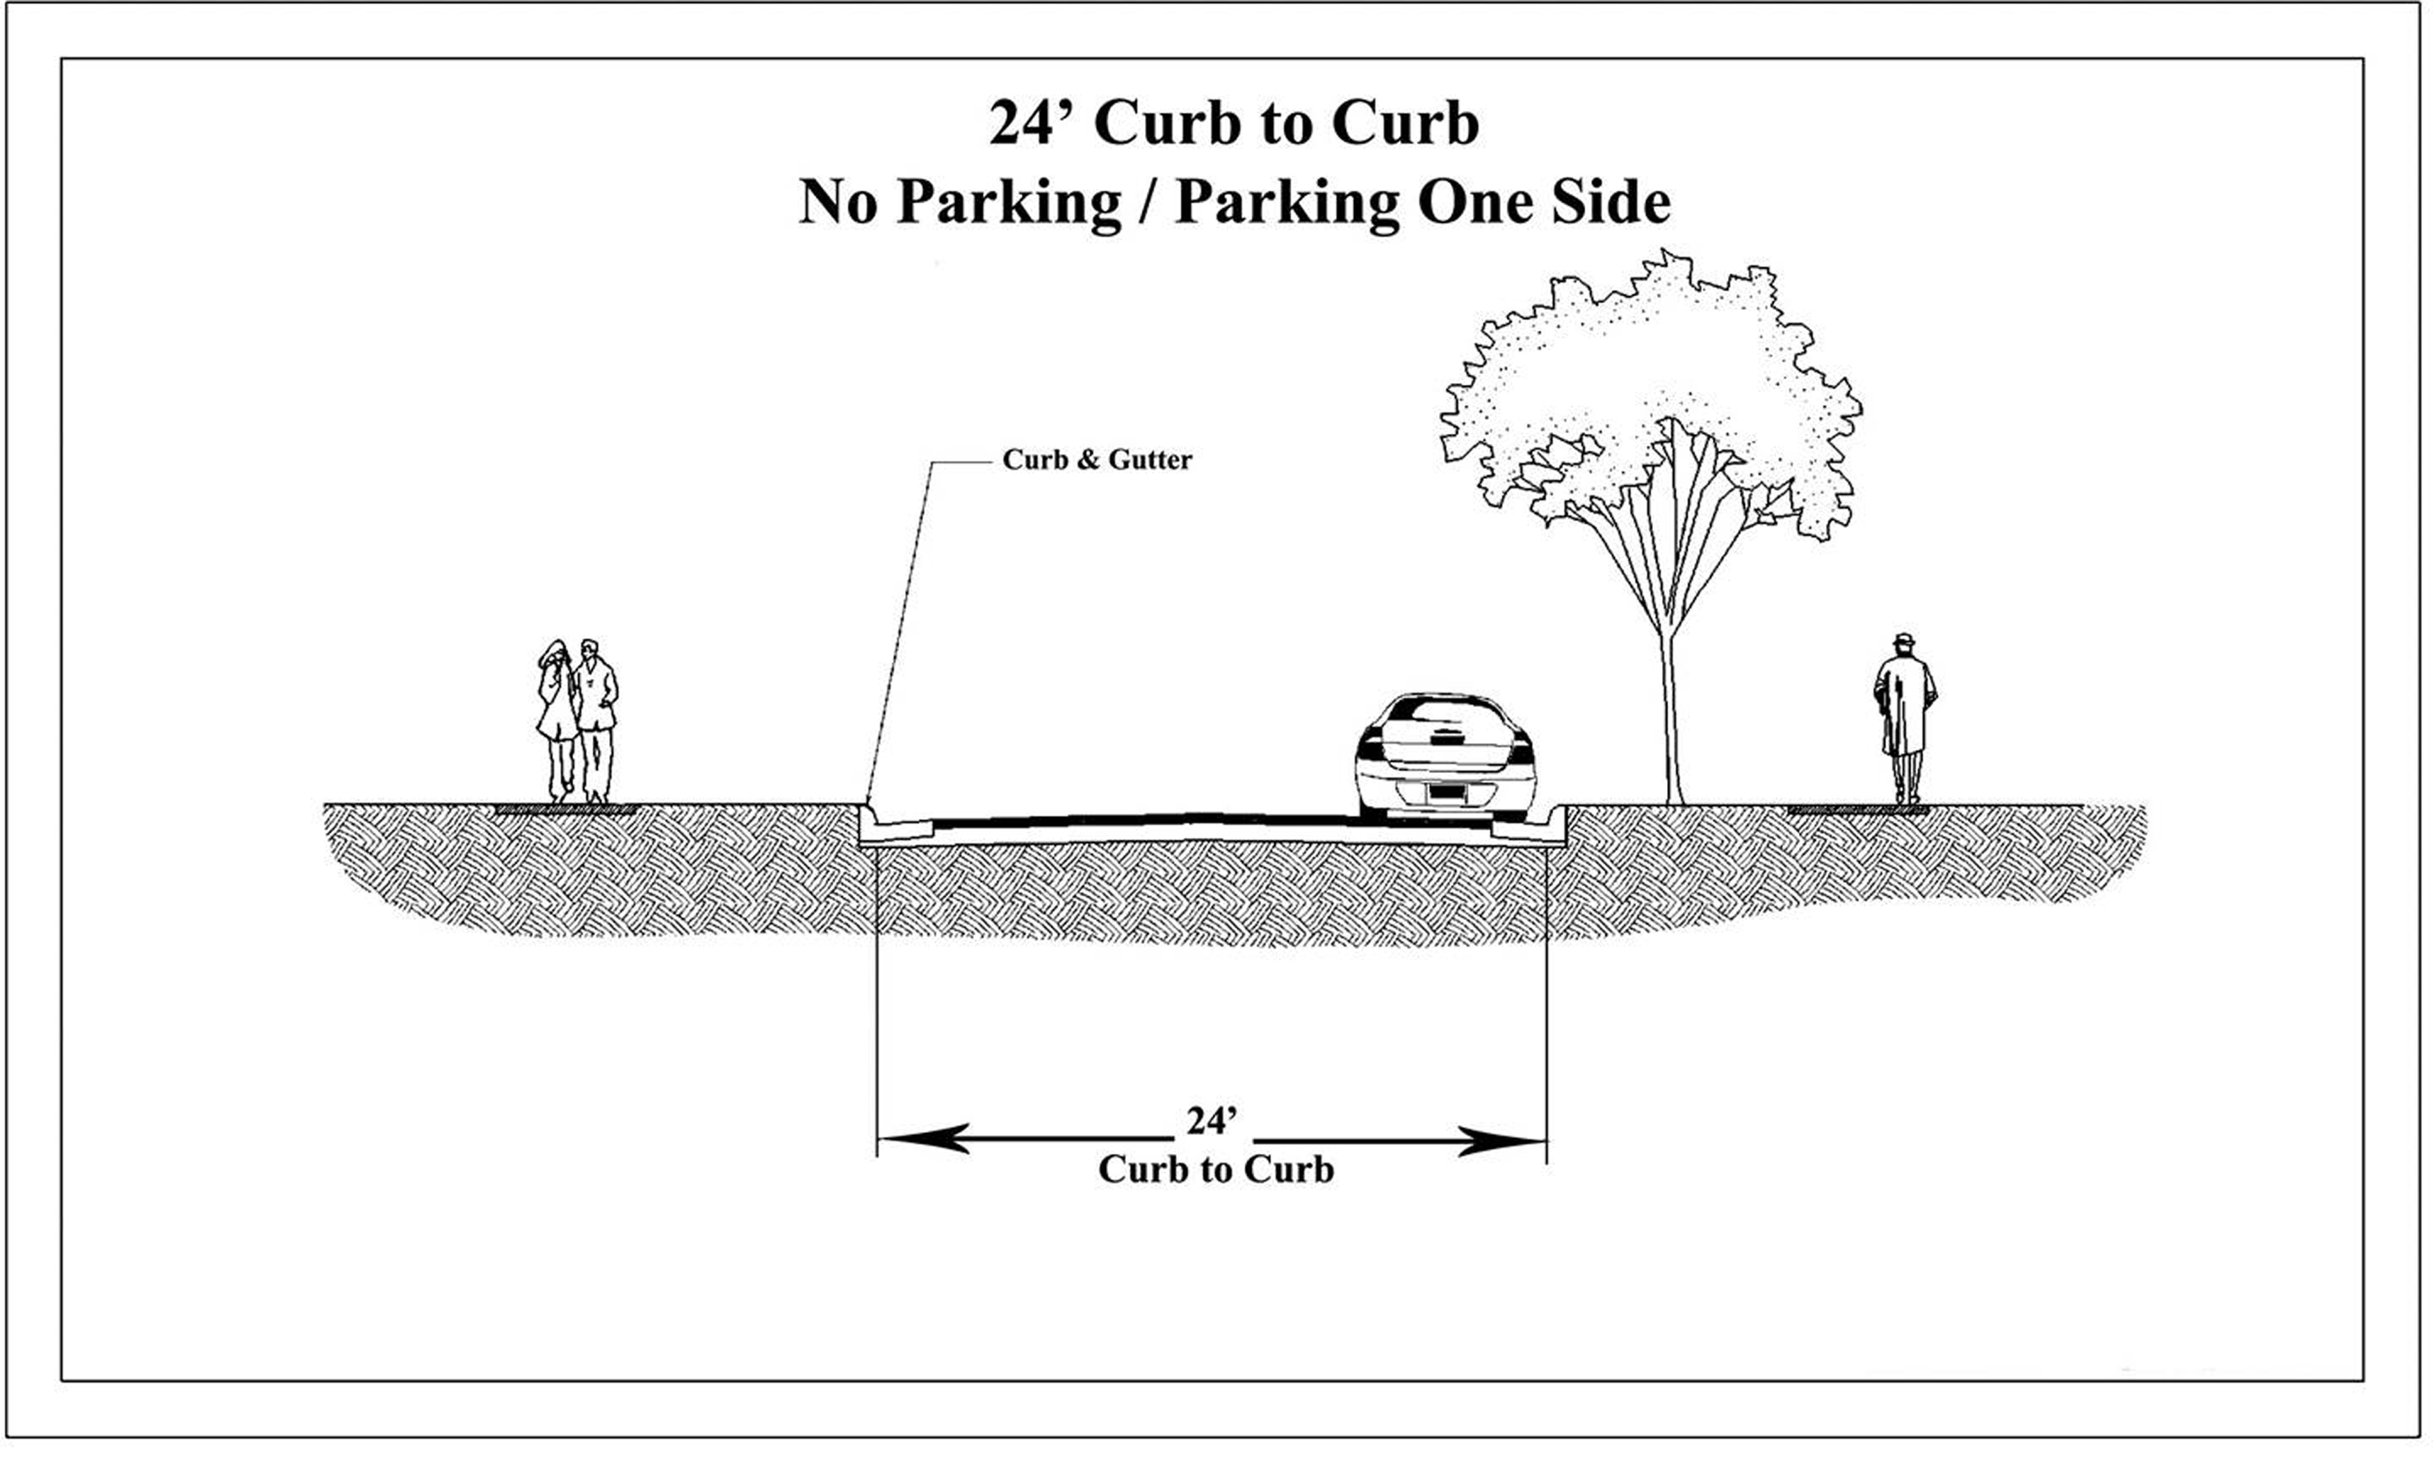

Slide 35
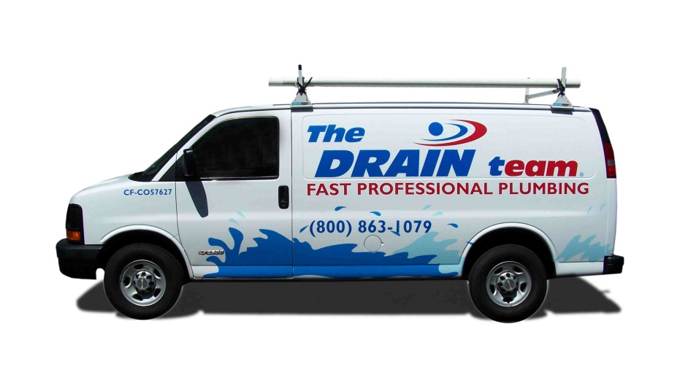
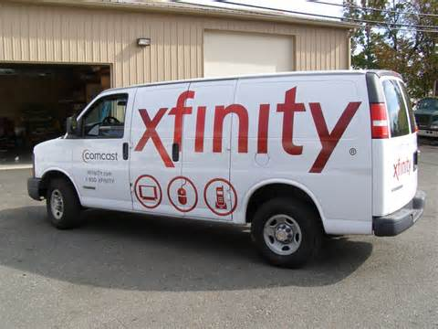
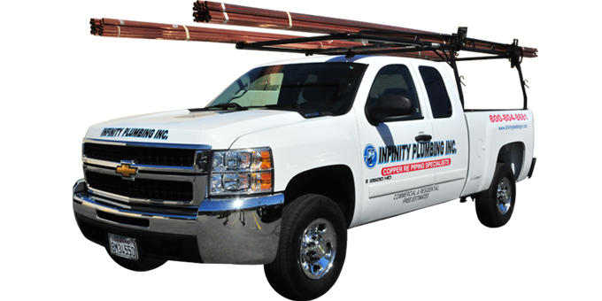
Company Trucks
Company trucks (i.e. vans with company logos) are not considered commercial vehicles and can park on state maintained roadways.
http://www.bing.com/images/search?q=commercial+trucks+vans+with+logos&qs=n&form=QBIR&pq=commercial+trucks+vans+with+logo&sc=1-22&sp=-1&sk=#view=detail&id=CC8B712D33033AA7B87D21791A30DC2E105ED29E&selectedIndex=11
http://www.bing.com/images/search?q=commercial+work+truck+plumbing&qs=n&form=QBIR&pq=commercial+work+truck+plumbing&sc=0-21&sp=-1&sk=#view=detail&id=6F81D90921D775D5F51A30B863C98E0D3144A02F&selectedIndex=23
http://www.bing.com/images/search?q=commercial+trucks+vans+with+logos&qs=n&form=QBIR&pq=commercial+trucks+vans+with+logo&sc=1-22&sp=-1&sk=#view=detail&id=77E31E3716A6881EE577585037A673ECB9776B57&selectedIndex=29

Slide 36
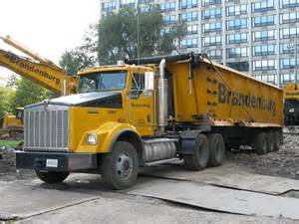
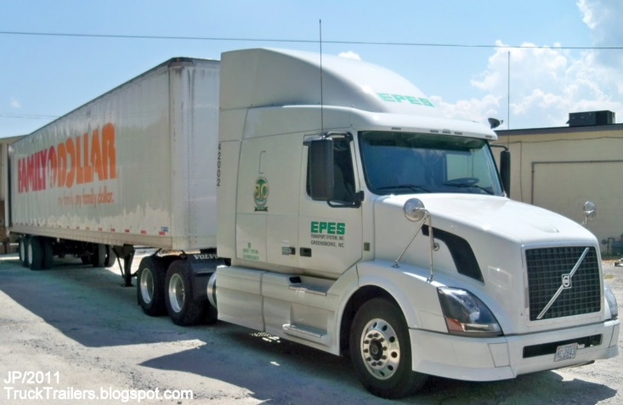
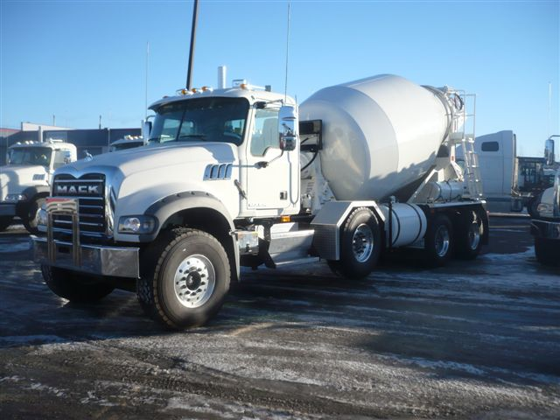
Commercial Vehicles
Prince William County Code Section 13-327 states that commercial vehicles are prohibited from parking in any residence district countywide.
(Resident District is where 75 percent or more of the property on either side of the highway, for 300 feet or more consists of land improved for dwelling purposes (Code of VA))
http://www.bing.com/images/search?q=tractor+truck&qs=n&form=QBIR&pq=tractor+truck&sc=8-4&sp=-1&sk=#view=detail&id=7DC89F8DA1F3BB27138FD8A0E3AD771A93839D2B&selectedIndex=0
Commercial vehicles are:
Tractor truck or tractor truck/semitrailer or tractor truck/trailer combination.
Dump truck
Concrete mixer truck
Towing and recovery vehicle with a registered gross weight of 12,000 pounds or more
Heavy construction equipment
http://4.bp.blogspot.com/-OlLJM2eGQy8/TlrcB5PX5dI/AAAAAAAEXxM/3Et6QTz0s1w/s1600/EPES+TRANSPORT+SYSTEM+GREENSBORO+NORTH+CAROLINA+Trucking+CO.%252CFamily+Dollars+Store+Trailer+Delivery%252CEpes+Volvo+Tractor+Truck.JPG
http://www.bing.com/images/search?q=concrete+mixer+truck&qs=n&form=QBIR&pq=concrete+mixer+truck&sc=8-8&sp=-1&sk=#view=detail&id=489AE1533EBE8FF63CA6F0DEFA973669581E4CE0&selectedIndex=13

Slide 37
Prince William County Code - Sec. 13-320. General Parking Prohibitions
(a) No person shall park a vehicle, except when necessary to avoid other traffic or in compliance with the directions of a police officer or traffic control device, in any of the following places:
(1) On a sidewalk.
(2) Within an intersection.
(3) In front of a public or private driveway.
(4) Within 15 feet of a fire hydrant.
(5) On a crosswalk.
(6) Within 20 feet of a crosswalk at an intersection; provided that, where there is no crosswalk at an intersection, no person shall park a vehicle within 20 feet from the intersection of curb lines or, if none, within 15 feet of the intersection of property lines.
(7) Within 30 feet of any flashing beacon, stop sign or traffic control signal located at the side of a roadway.
(8) Between a safety zone and the adjacent curb or within 30 feet of points on the curb immediately opposite the ends of a safety zone, unless a different length is indicated by official signs or markings.
(9) Within 50 feet of the nearest rail of a railroad grade crossing.
(10) Within 15 feet of the driveway entrance to any fire station and, on the side of a street opposite the entrance to any fire station, within 75 feet of the entrance, when properly signposted.

Slide 38
THANK YOU
DEPARTMENT OF TRANSPORTATION
STEVE STEVENS : 703 792 6817, sstevens@pwcgov.org
PAOLO BELITA: (703) 792 8002, pbelita@pwcgov.org

Slide 39
Questions?
Officer Mark Merriman, Prince William County
Police Department
Steven Stevens, Engineer III, Prince William County
Department of Transportation
Paolo Belita, Engineer I, Prince William County
Department of Transportation
John Settlemyer, Chief Property Code Enforcement Inspector
Neighborhood Services Division

