Slide 1

The Real Scoop: Pet Waste and Your Community
presented by
David Jensen
Director of Business Development DoodyCalls

Slide 2

DoodyCalls – Some background
    DoodyCalls was founded by Susan and Jacob D’Aniello in 2000 in Fairfax, VA. In 2004 DoodyCalls became the first national pet waste removal franchise. Today, DoodyCalls franchise owners “scoop the poop” from coast to coast.
      Experts in pet waste management
      More than 14 years of experience
      managing pet waste.
        Residential yard cleanings
        Community common area
        cleanings (pet/goose)
        Pet waste station sales and service

Slide 3
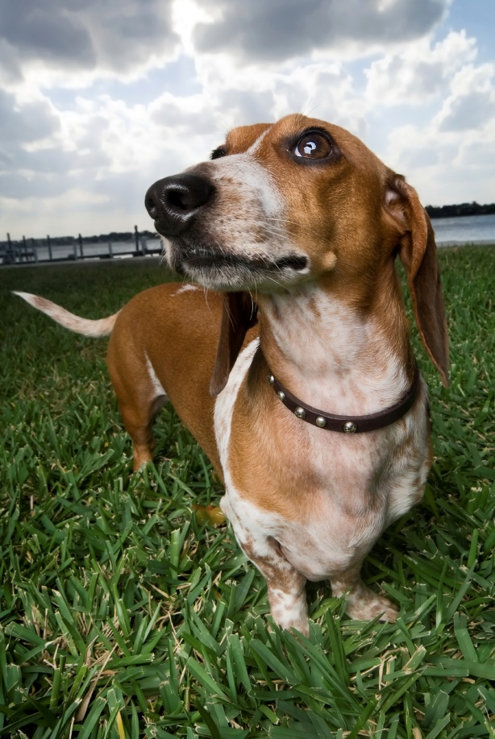
DoodyCalls – Some background
      Nationwide product and service sales
      Largest pet waste management company in the world

Slide 4
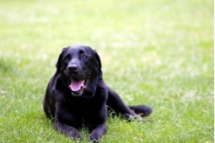
Today’s Presentation
Health hazards
Environmental effects
Dog “Poo”llution solutions
Benefits of working with a professional pet waste management company
To make sure all of your questions are answered about managing waste at your communities!

Slide 5


The Problem
There is a lot of it!
  40% of U.S. households have dogs
  The average dog deposits ¾ lb. waste per day
  That's 30,000 tons of dog waste deposited every day in the U.S. & 10 million tons per year
  100% of those owners DO NOT enjoy picking up what their dog leaves behind

Slide 6
The Problem
Dog waste can harm your health
  Dog waste is a non-point source pollution (EPA)
  Two to three days of droppings from 100 dogs can contribute enough bacteria to close a bay and all watershed areas within 20 miles to swimming and shell fishing
  Roundworm is one of the most common parasites found in dog waste and it can remain infectious in dog waste for years.
  Bacteria, worms and other parasites are found in dog waste and can wash into our water supply

Slide 7
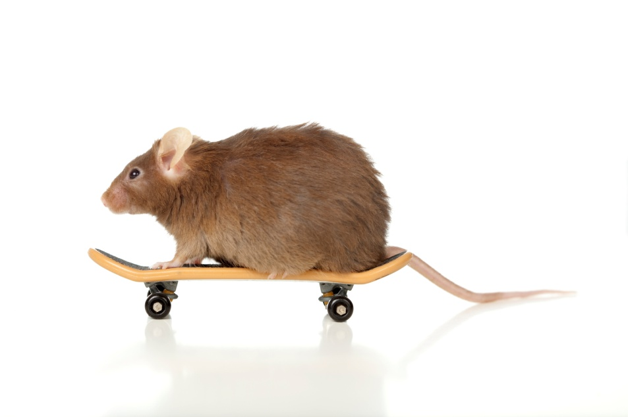
The Problem
Pet waste attracts rats & rodents
  Dog food is high in protein. Dogs can not break down all of the protein and the body discards undigested food. This waste provides a food source for rats.

Slide 8

The Problem
Dog waste creates conflict
  Residents do not like dog poop in their yard or common areas. They either confront offending dog owners or dump the issue on the board of directors to resolve.

Slide 9

Top FIVE common resident complaints
People aren’t picking up after their dogs
Waste everywhere – the community looks dirty
I stepped in dog doody again
The trash cans are overflowing and there are dog waste bags on the ground
My kids can’t play at the playground because there is so much dog doody it’s not safe for them!

Slide 10
Top FIVE common manager questions
How do we encourage residents to pick up after their dogs?
How do we reduce the number of complaints we’re getting about dog poop?
Can you believe the board wants me to empty the dog stations again because they are overflowing?
Where do I go for help on this?
Can we afford to outsource this to an expert?

Slide 11
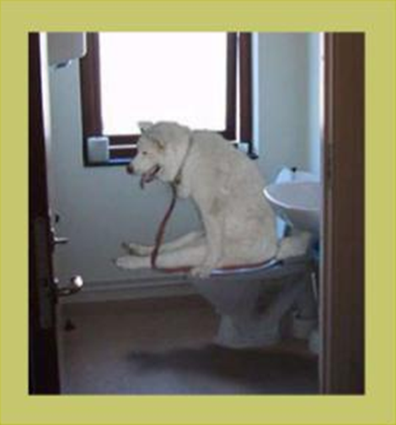
The Solution
If you allow dogs and you don’t have a pet waste management plan in place then a pet waste problem is inevitable
The solution is to implement a strategy to successfully manage the problem

Slide 12

The Solution
1. Do it yourself
  Form a committee
    (Trails and Tails)
  Consult resources
    DoodyCalls Community Management Pet Waste Guide
    CAI materials
2. Outsource to Specialists
3. A combination of the two

Slide 13

Waste Management Options
Volunteers
  Can be difficult to hold accountable
  May quickly become discouraged when confronted with the often unanticipated “yuck“ factor of the job

Slide 14

Waste Management Options
Landscapers
  May be able to perform service while on site
  Pet waste management is not their primary focus
  Harder to hold accountable for pet waste management
  Most lack experience with pet waste management plan development or execution, and may not be able to provide resident education

Slide 15
Waste Management Options
Pet Waste Management Companies
  Extensive experience in creating and implementing comprehensive pet waste management plans that are customized to fit a community's needs and budget
  Single point accountability for pet waste issues
  Understand the importance of – and can assist with – resident education
  Resident hand outs, newsletter content, board meeting presentations
  Pet waste station service and maintenance
  Common area cleanings

Slide 16
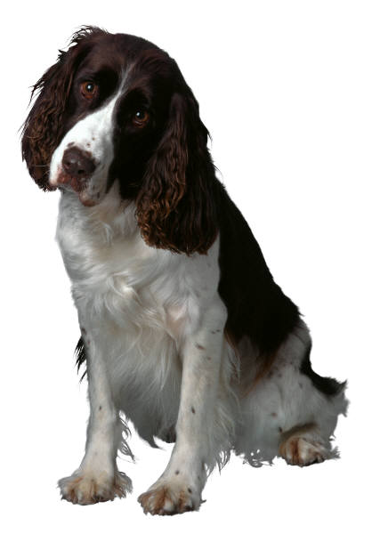
Waste Management Options
No matter who you work with, ask for references and make sure they are 100% committed to helping you make all of your pet waste problems go away!

Slide 17
Service Providers
Questions to ask your service provider include:
How long has your company been in business?
Do you provide educational material for our residents?
How many communities do you currently service?
How many pet waste technicians (scoopers) do you have on staff?
Are your technicians employees of your company or are they independent contractors?
Do the technicians wear uniforms and drive marked vehicles?
What does your company do with the collected waste? Will it be placed in our community’s dumpsters or will it be disposed of off-site?
If the waste is taken off-site, how does your company then dispose of it?
What is your policy on service issues? Who do we contact in such an event and how?

Slide 18

What not to doo!
In ground waste digesters (Doggie Doolies)
  Requires constant maintenance
  May be become unusable due to trash dumping
  May not degrade bags
  May not drain properly
  Child safety hazard
Heavy handed enforcement approach without providing a genuine solution
Under investing
  Station quality, number of stations, bag provision and service frequency
Turning a blind eye to the problem

Slide 19

Questions?
Feel free to ask
any questions
you may have.

Slide 20
Tactics: Overview
Effective strategies include the following tactics:
  1. Education
    Educate residents about the importance of picking up after their dogs
  2. Pet Waste Stations
    Provide residents with the tools to do what's right
    Make them as easy as possible to utilize
  3. Common Area Cleanings
    Have a system in place for “removing” what still winds up on the ground

Slide 21
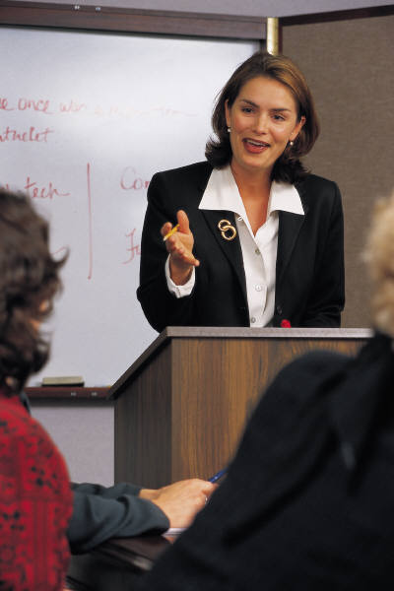
Tactics: Education
  Distribute monthly education material
  Invite guest speakers to association meetings
      Storm water management
        http://www.onlyrain.org/
      Local watershed protection groups
        http://www.aawsa.org/

Slide 22
Tactics: Education
Initial Education
  Educate residents through newsletters and board meetings about the health, financial, and legal aspects of picking up after their dogs
Ongoing Education
  Educate residents about the problem
  Educate residents about your policies and solutions
  Reinforce the policies and the positives

Slide 23

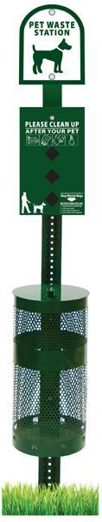
Tactics: Pet Waste Stations
Dog waste bag dispenser
Waste receptacle
Station sign
®
®
The Sentry® and The Gladiator® are registered Trademarks of ZW USA INC.

Slide 24
Tactics: Pet Waste Stations
  Number of stations
      Community size and layout are major factors
      Consider density of homes and areas where dog owners tend to congregate, play or walk
      Develop long term plan to account for community growth
  Use the correct type of station for the location
  Keep convenience in mind
      Place stations at intersections of paths
      The goal is to make it easy to pick up a bag at the start of a walk and easy to drop it off by the end

Slide 25
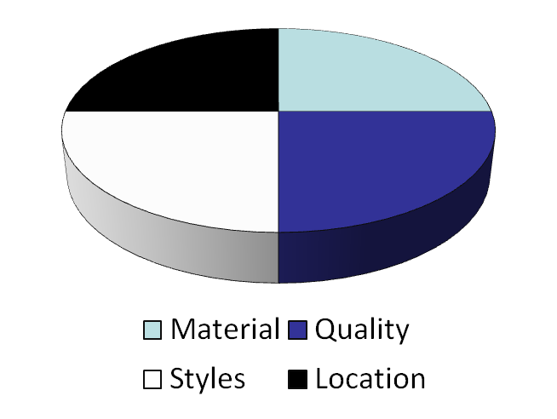
Tactics: Pet Waste Stations
  Material
    Plastic, Aluminum, Steel
    We recommend aluminum for its durability and rust resistant qualities
  Quality
    Many new entrants into the market
    Reputability counts
  Styles:
    Heavy duty, standard, dispenser only
  Location
    Intersections of paths
    Locations where dog owners congregate

Slide 26
Tactics: Dog Waste Bags
Dog Waste Bags
  Material
    Biodegradable
      Pro: Completely breaks down into compostable material
      Con: Generally the highest cost
    Oxo-biodegradable
      Pro: Breaks down into the material’s carbon base when exposed to oxygen
      Pro: Provides a good compromise between cost and environmental considerations
      Con: Not compostable
Disclaimer: We do not make any claims regarding our bags in terms of "biodegradable" or "degradable" or "decompostable" or in any way imply that the bags will break down in a landfill or incinerator. California has a specific ASTM6400 Standard for plastic bags. All bags marked "oxo-biodegradable" do not meet the California ASTM6400 standard.

Slide 27
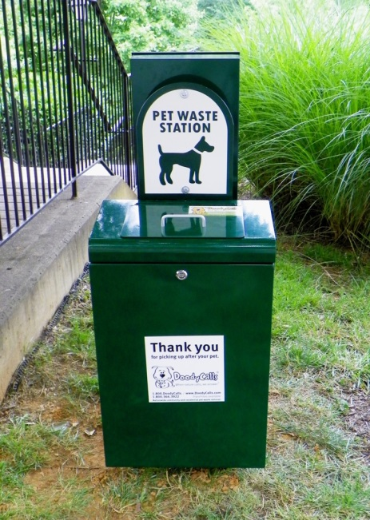
Tactics: Dog Waste Bags
  Material
    Non-degradable
      Pro: Generally the least expensive
      Pro: Bags made from non-degradable plastic are generally more tear-resistant than bags made from degradable plastic
      Con: Takes hundreds of years to break down
  Quality
    Bags vary greatly in thickness
      In the absence of thickness measurements, look at case weight
      As a rule of thumb for determining the quality: A case of 2,000 bags should weigh approximately 14 lbs
      Lower weight means less plastic and a lower level of quality

Slide 28
Tactics: Dog Waste Bags
  Style
    Roll Bags
      Pro: Lowest per bag cost
      Con: Susceptible to vandalism
      Con: People generally take multiple bags at a time and so they may have a higher true cost overall
    Single Pull
      Pro: Generally larger and easier to use than a roll bag
      Pro: Lower actual usage numbers
      Pro: Frequently less expensive overall (in implementation)
      Con: May have a higher per bag cost

Slide 29

Tactics: Pet Waste Products
Products
  When choosing who to order products from consider:
    How long have they been in business?
    Can you purchase over the phone, internet, or both?
    How easy is it to order and receive products?
    How is payment required?

Slide 30

Tactics: Station Service
Pet Waste Station Service
  Frequency:
    Not less than every other week
    Some cans may require twice weekly service
    Frequency can be adjusted by modifying the size of the receptacle

Slide 31
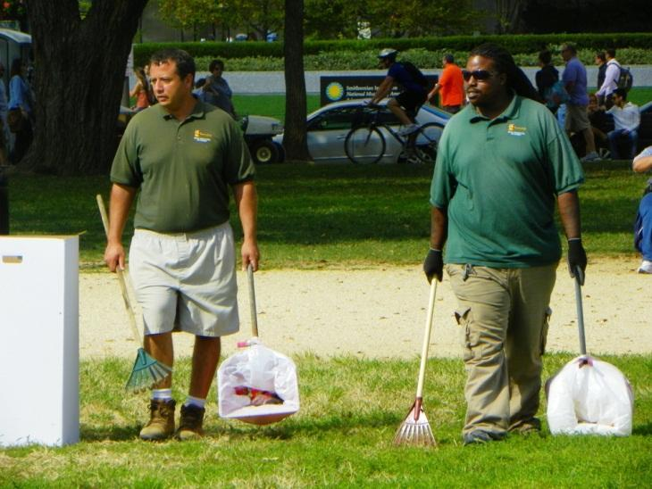
Tactics: Common Area Cleanings
What are common area
cleanings?
  Patrol common areas and
  paths for pet waste and
  loose trash
Why do we need them if we have stations?
  Tandem solution with pet waste stations improves overall effectiveness

Slide 32
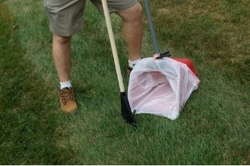
Tactics: Common Area Cleanings
How often do we need them?
  Seasonality considerations
  Cold weather “preserves,” the poop for spring surprises
How to manage the contract effectively?
  Meet with the waste management company to clearly identify problem areas
  Keep the waste management company updated about any areas that experience an increase in use

Slide 33

It’s Important!
Pet waste management is an important and necessary aspect of a community manager’s job

Slide 34

Questions?
Feel free to ask any questions you may have.

Slide 35
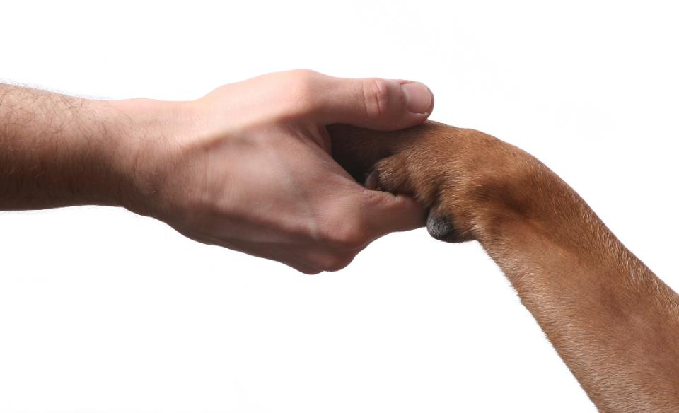
Final Thoughts
Notes:
35

Slide 36
The Real Scoop: Pet Waste and Your Community
David Jensen
Director of
Business Development
DoodyCalls
(800) 366 3922
(703) 348-5292
djensen@doodycalls.com
www.DoodyCalls.com
Notes:
36

