Slide 1
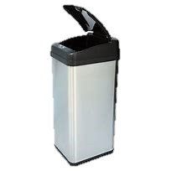
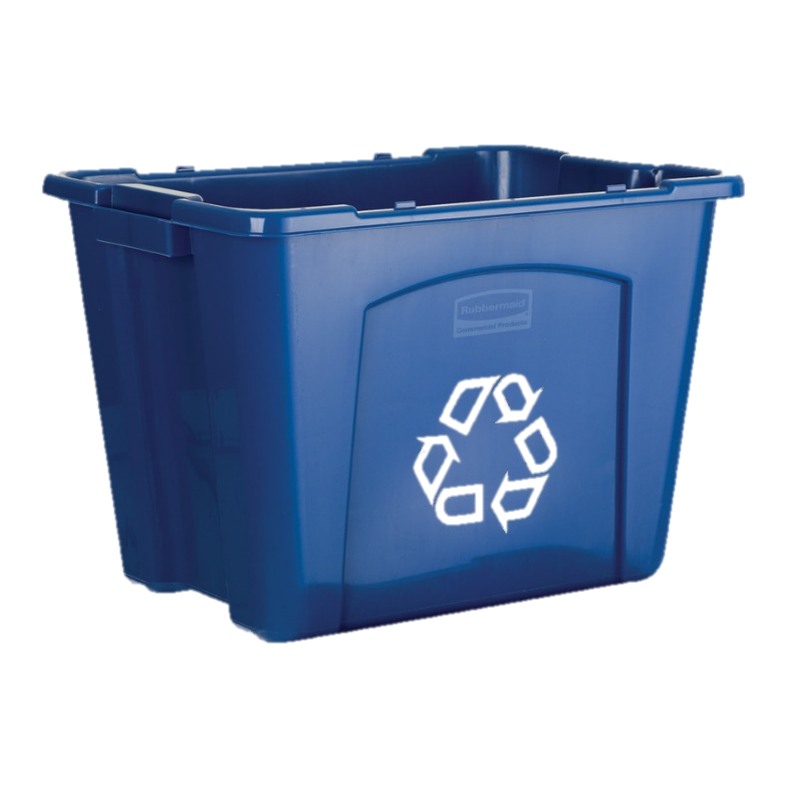
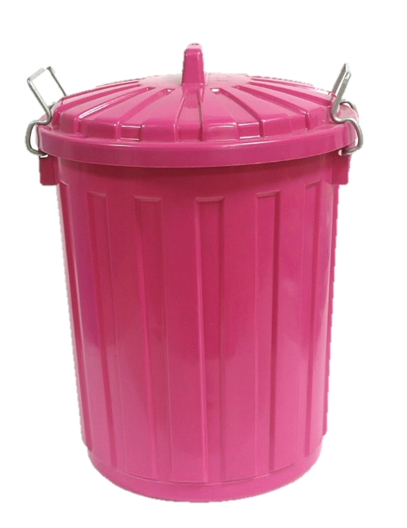
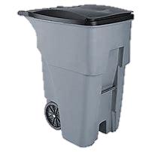

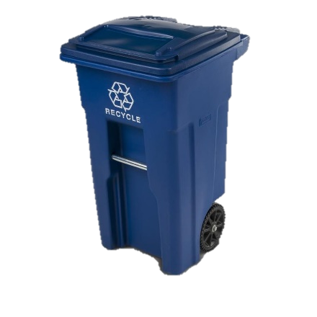
Take out the Trash
Household Trash
Recycling Bin
Special Attention

Slide 2
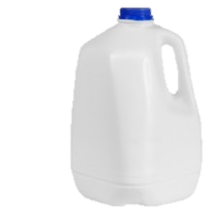

Milk or Juice
Plastic Bottle
Household Trash
Recycling Bin
Special Attention

Slide 3

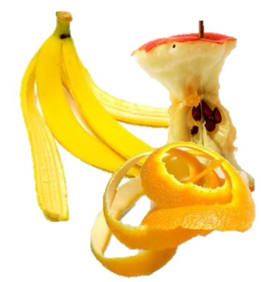
Food Waste
Household Trash
Recycling Bin
Special Attention

Slide 4
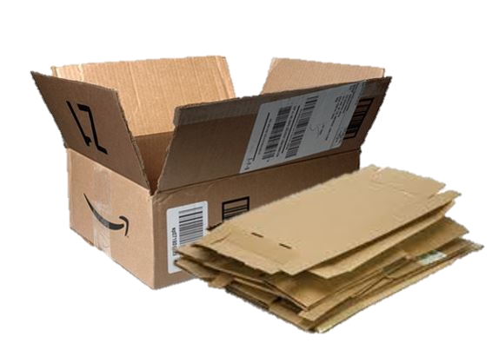

Cardboard Boxes
Household Trash
Recycling Bin
Special Attention

Slide 5
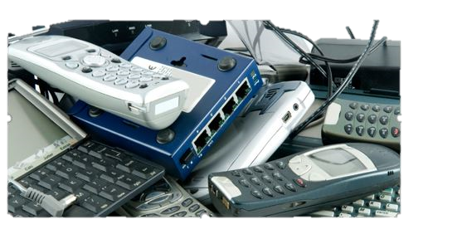


Electronics
Household Trash
Recycling Bin
Special Attention

Slide 6
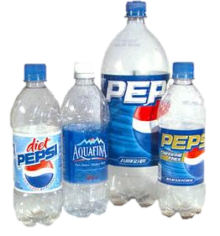
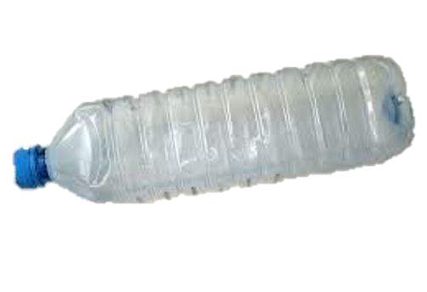

Plastic Water and Soda Bottles
Household Trash
Recycling Bin
Special Attention
Notes:
Needs aminimation help—soda bottles don’t go in to the bin

Slide 7
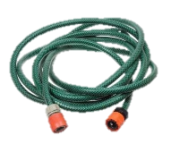
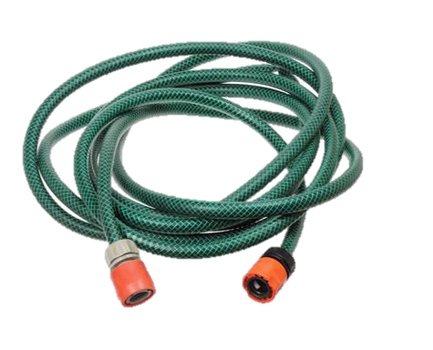
Garden Hose
Household Trash
Recycling Bin
Special Attention

Slide 8
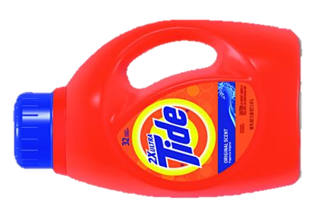
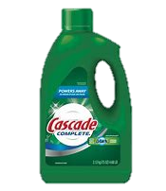


Laundry and Dishwasher Detergent Bottle
Household Trash
Recycling Bin
Special Attention

Slide 9


Newspapers
Household Trash
Recycling Bin
Special Attention

Slide 10
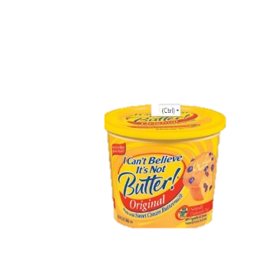
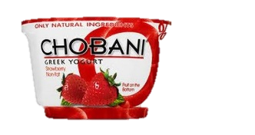
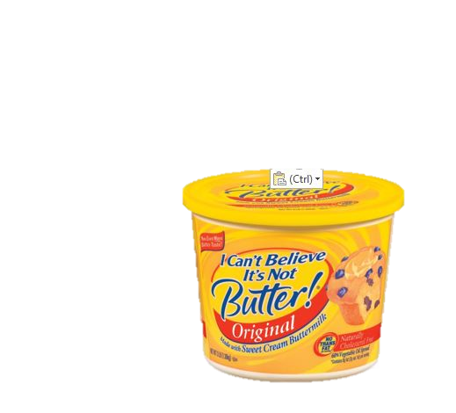
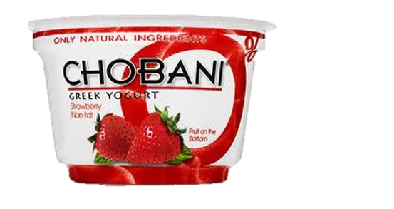
Plastic Food Tubs
Household Trash
Recycling Bin
Special Attention

Slide 11
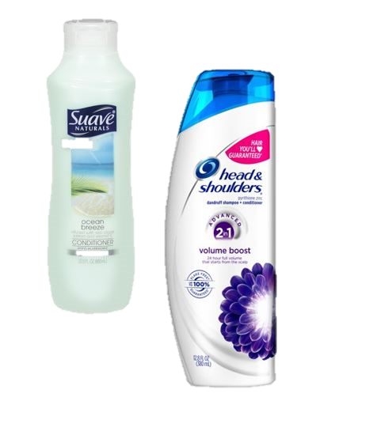
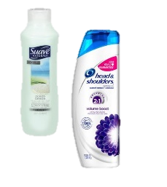
Shampoo and Conditioner Bottles
Household Trash
Recycling Bin
Special Attention

Slide 12
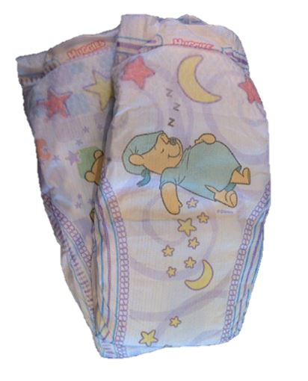

Disposable Diaper
Household Trash
Recycling Bin
Special Attention

Slide 13
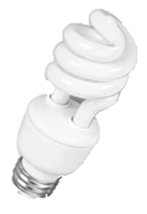
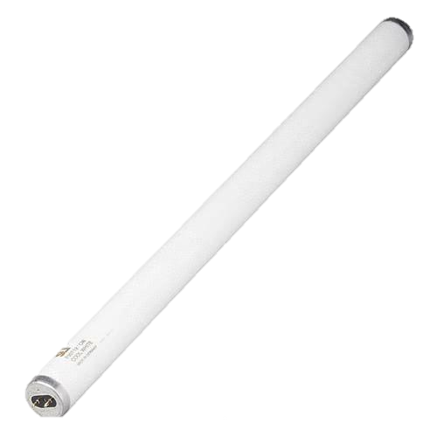
Fluorescent Bulbs
Household Trash
Recycling Bin
Special Attention

Slide 14
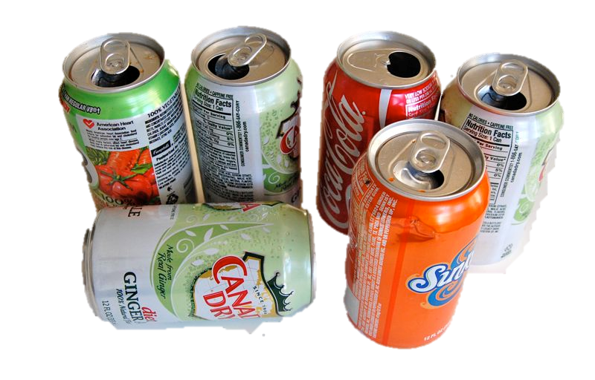
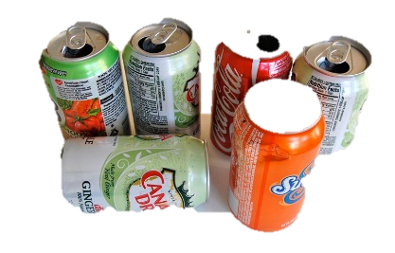
Aluminum Cans
Household Trash
Recycling Bin
Special Attention

Slide 15
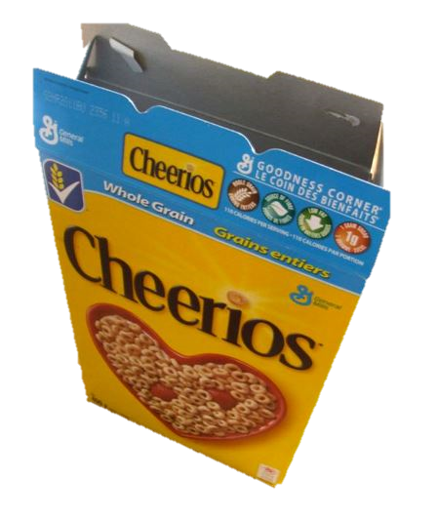
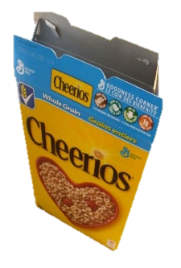
Cereal Boxes
Household Trash
Recycling Bin
Special Attention

Slide 16
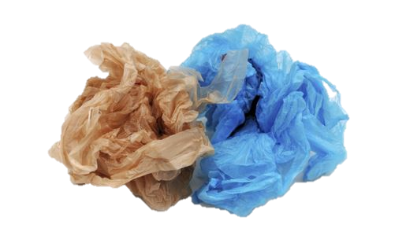
Single-Use Plastic Bags
Household Trash
Recycling Bin
Special Attention
Notes:
Your can also recycle case wrap and dry cleaning bags in same retail outlets. www.filmrecycling.org

Slide 17
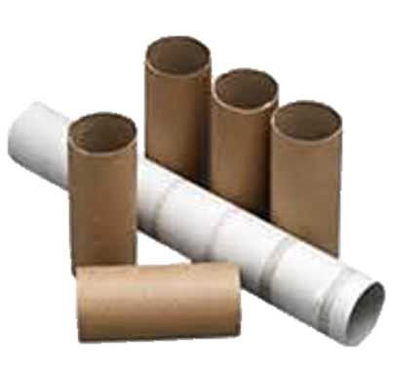
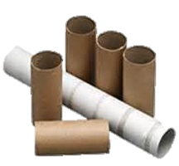
Toilet Tissue and Paper Towel Cores
Household Trash
Recycling Bin
Special Attention

Slide 18
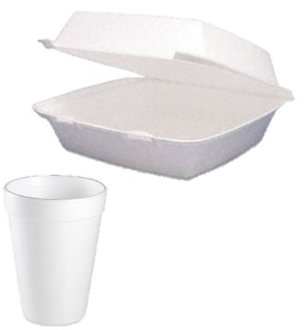

Styrofoam®
Household Trash
Recycling Bin
Special Attention

Slide 19
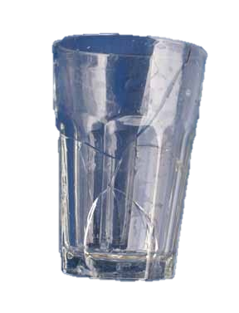
Drinking Glass
Household Trash
Recycling Bin
Special Attention

Slide 20
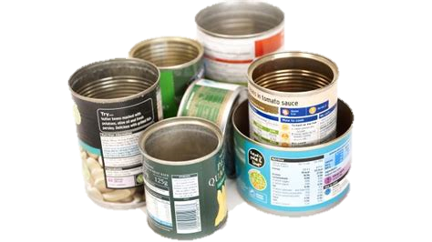

Metal Cans
Household Trash
Recycling Bin
Special Attention

Slide 21
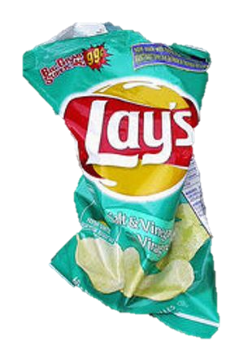
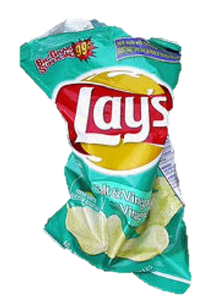
Chip/Snack Bag
Household Trash
Recycling Bin
Special Attention

Slide 22
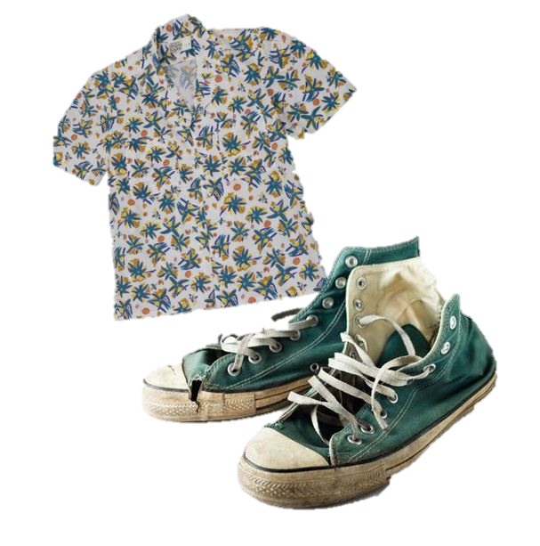

Clothing and Shoes
Household Trash
Recycling Bin
Special Attention
Notes:
Fix animation Donate clothing, shoes and textile items.

Slide 23
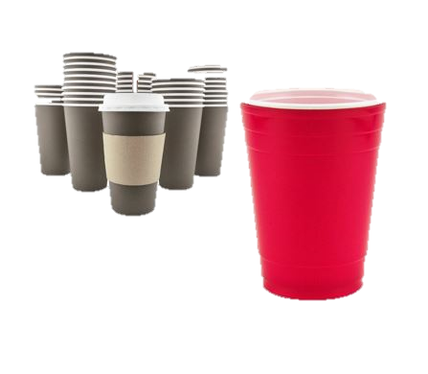
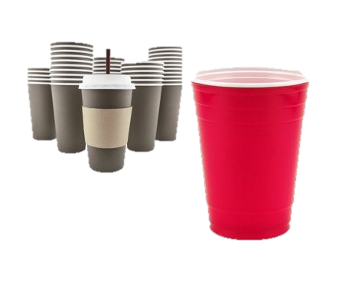
Take-out Beverage Cups
Household Trash
Recycling Bin
Special Attention

Slide 24

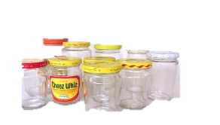
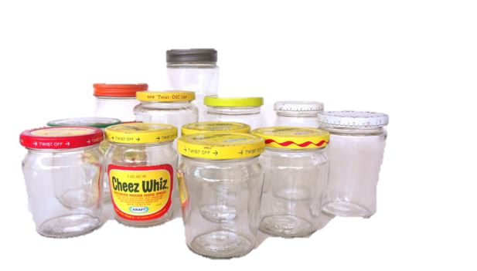
Glass
Bottles & Jars
Household Trash
Recycling Bin
Special Attention
Notes:
Needs animation work

Slide 25
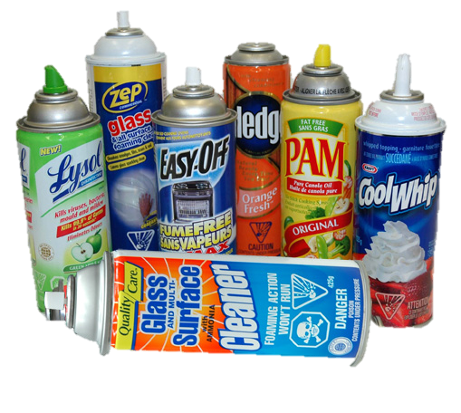
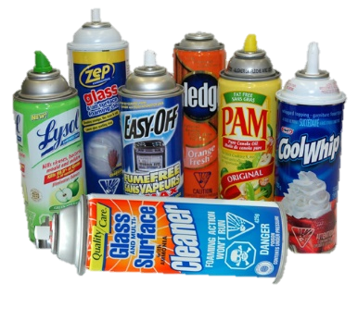
Aerosol Cans
Household Trash
Recycling Bin
Special Attention

Slide 26
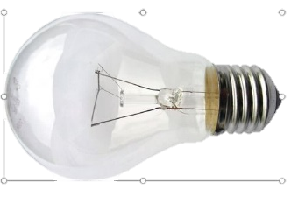
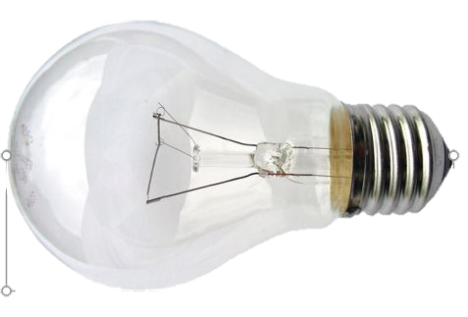
Incandescent bulb
Household Trash
Recycling Bin
Special Attention

Slide 27
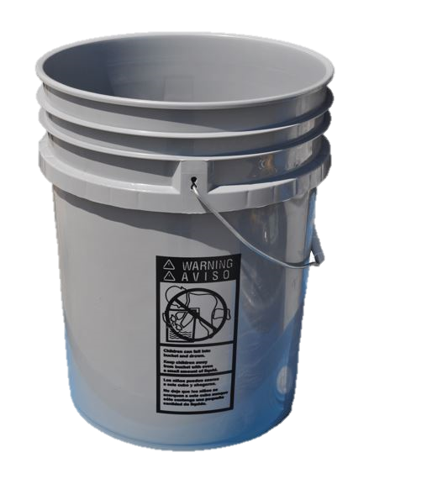
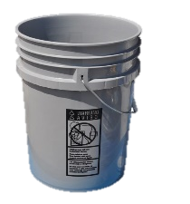
Rigid Plastics
Household Trash
Recycling Bin
Special Attention

Slide 28
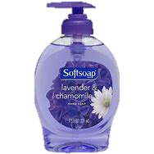
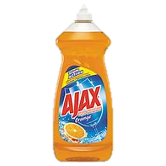
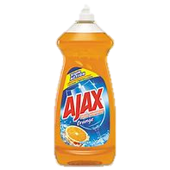
Plastic Soap Bottles
Household Trash
Recycling Bin
Special Attention

Slide 29


Cartons
Household Trash
Recycling Bin
Special Attention

Slide 30


Batteries
Household Trash
Recycling Bin
Special Attention

Slide 31




Plastic Take-out Containers
Household Trash
Recycling Bin
Special Attention

Slide 32


Needles, Sharps, Syringes
Household Trash
Recycling Bin
Special Attention
Notes:
Place sharps in heavy plastic detergent bottle, secure lid. Mark “SHARPS-Do not Recycle” and place in household trash

Slide 33
Keys to Successful Recycling
Recycle Right
Right item
Right Place
Right Preparation

